Slide 1
The Null Hypothesis Initiative
A/Prof Sandra Petty
CEO - Center for Biomedical Research Transparency, NY
Sandy@cbmrt.org

Slide 2
Research Transparency
It is vital for biomedical and clinical research reporting to be fully represented and transparent
Enhance efficiency
Inform future research design
For clinicians relying on information
Acknowledges contribution of researchers and research participants
For patient care
To reduce avoidable risks to patients

Slide 3
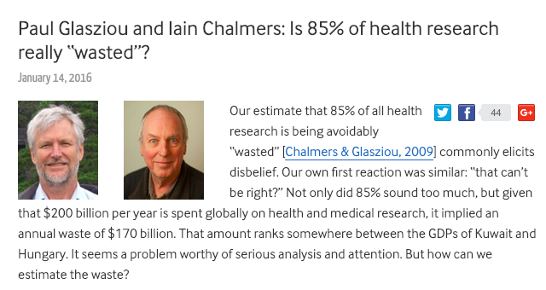
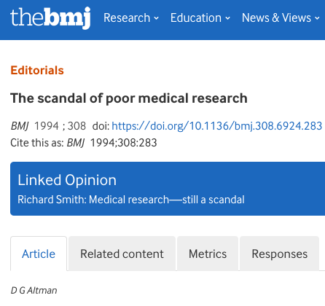
Biomedicine cannot afford reproducibility and reporting issues.
Glasziou and Chalmers - BMJ: $170 billion wasted annually. Factors include lack of:
Publication (up to 50% of studies)
methods and results not clearly shared
Systematic examination of prior research

Slide 4
Research Transparency Context
Rapid technological change
Technology for scientists expanding in and out of the lab
IT capability for dissemination of information
Trust in science
24 hour news cycle, social media, fake news
Public skepticism, Internet of largely unfiltered information
Limited funding and a highly competitive funding environment
Is it vital that science - including biomedical research gets transparency right.

Slide 5
Dark Data
Biomedicine’s unpublished data.
in lab books around the world
Despite the importance of reporting research outcomes many experimental results remain unpublished
This includes negative/inconclusive/replication findings
Significant value!
Inform future research design, funding decisions, and save study participants from avoidable risks.
As a physician, this issue is concerning; it is no less concerning for patients.

Slide 6
So What Happened?!
Study not started?
Changed plan, ethics, staffing or funding issue
Not completed?
Recruitment not reached
Funding problem
Side effect?
Completed but not written up?
Negative/ inconclusive result
Lab logistics eg student/scientist moved on
Data deliberately withheld?
Written up, but unpublished
Rejected?
Was it negative or inconclusive?
Other - quality issue?
Opportunity Cost
New research directions
Prior work not prioritized.

Slide 7
Unpublished research

Slide 8
Unpublished research: preclinical?
Even harder to track!
What’s the denominator?
New Preclinical trials registry - Dr. Mira van der Naald

Slide 9
What’s needed?
Systematic integrated approach to reporting results
from funders, ethics committees, researchers, research publication media and institutional infrastructure to enhance research reporting
Can ethics or governance committees and funders ensure write up and dissemination of results?
Funding project timelines including time to write up
Expanding role for preprints and data sharing
Available and appropriate spaces to publish studies - including negative, inconclusive and replication work

Slide 10
Publication Bias
Factors likely varied
Competition for limited space in high impact journals
Opportunity cost from writing up to publication
Negative/inconclusive results?
cultural perception of negative impact on career
perception of negative results as lower quality / less valued / or even undesirable to publish
These results can seem harder to publish in quality journals
Intentional non-disclosure of clinically important results however, signals a significant ethical/legal issue
What are the barriers to publication?

Slide 11
Publication environment
Negative study journals/online options exist, but not often by specialty
Funding issues for labs
e.g. publishing costs and
Ongoing grant / funding concerns
Opportunity / time costs
Competition for space in higher impact publications
Impact factor / prestige issues / journal quality – where to submit?

Slide 12
Opportunity
The Final Rule – clinical trial reporting legislation
There is a need for timely data and results reporting
Data does not stand alone
ideally, needs a narrative from the data source
Appropriate peer review or review structure
Creating additional space for the traditionally “harder-to-publish” full length papers

Slide 13
The Null Hypothesis Initiative (H₀)
Not only for Null Hypothesis papers, but other well-designed yet commonly perceived as harder to publish studies
Negative results (outright proof of Null effect not necessary)
Inconclusive results
Replication studies
Say it how it is

Slide 14
The Null Hypothesis Initiative (H₀)
Subscription business model likely challenging
CBMRT non-profit as a fundraising source to assist with costs
Working with major societies and their flagship journals
Utilizing existing networks and infrastructure
Promoting the special edition among researchers and society members
Enhancing research reporting culture

Slide 15
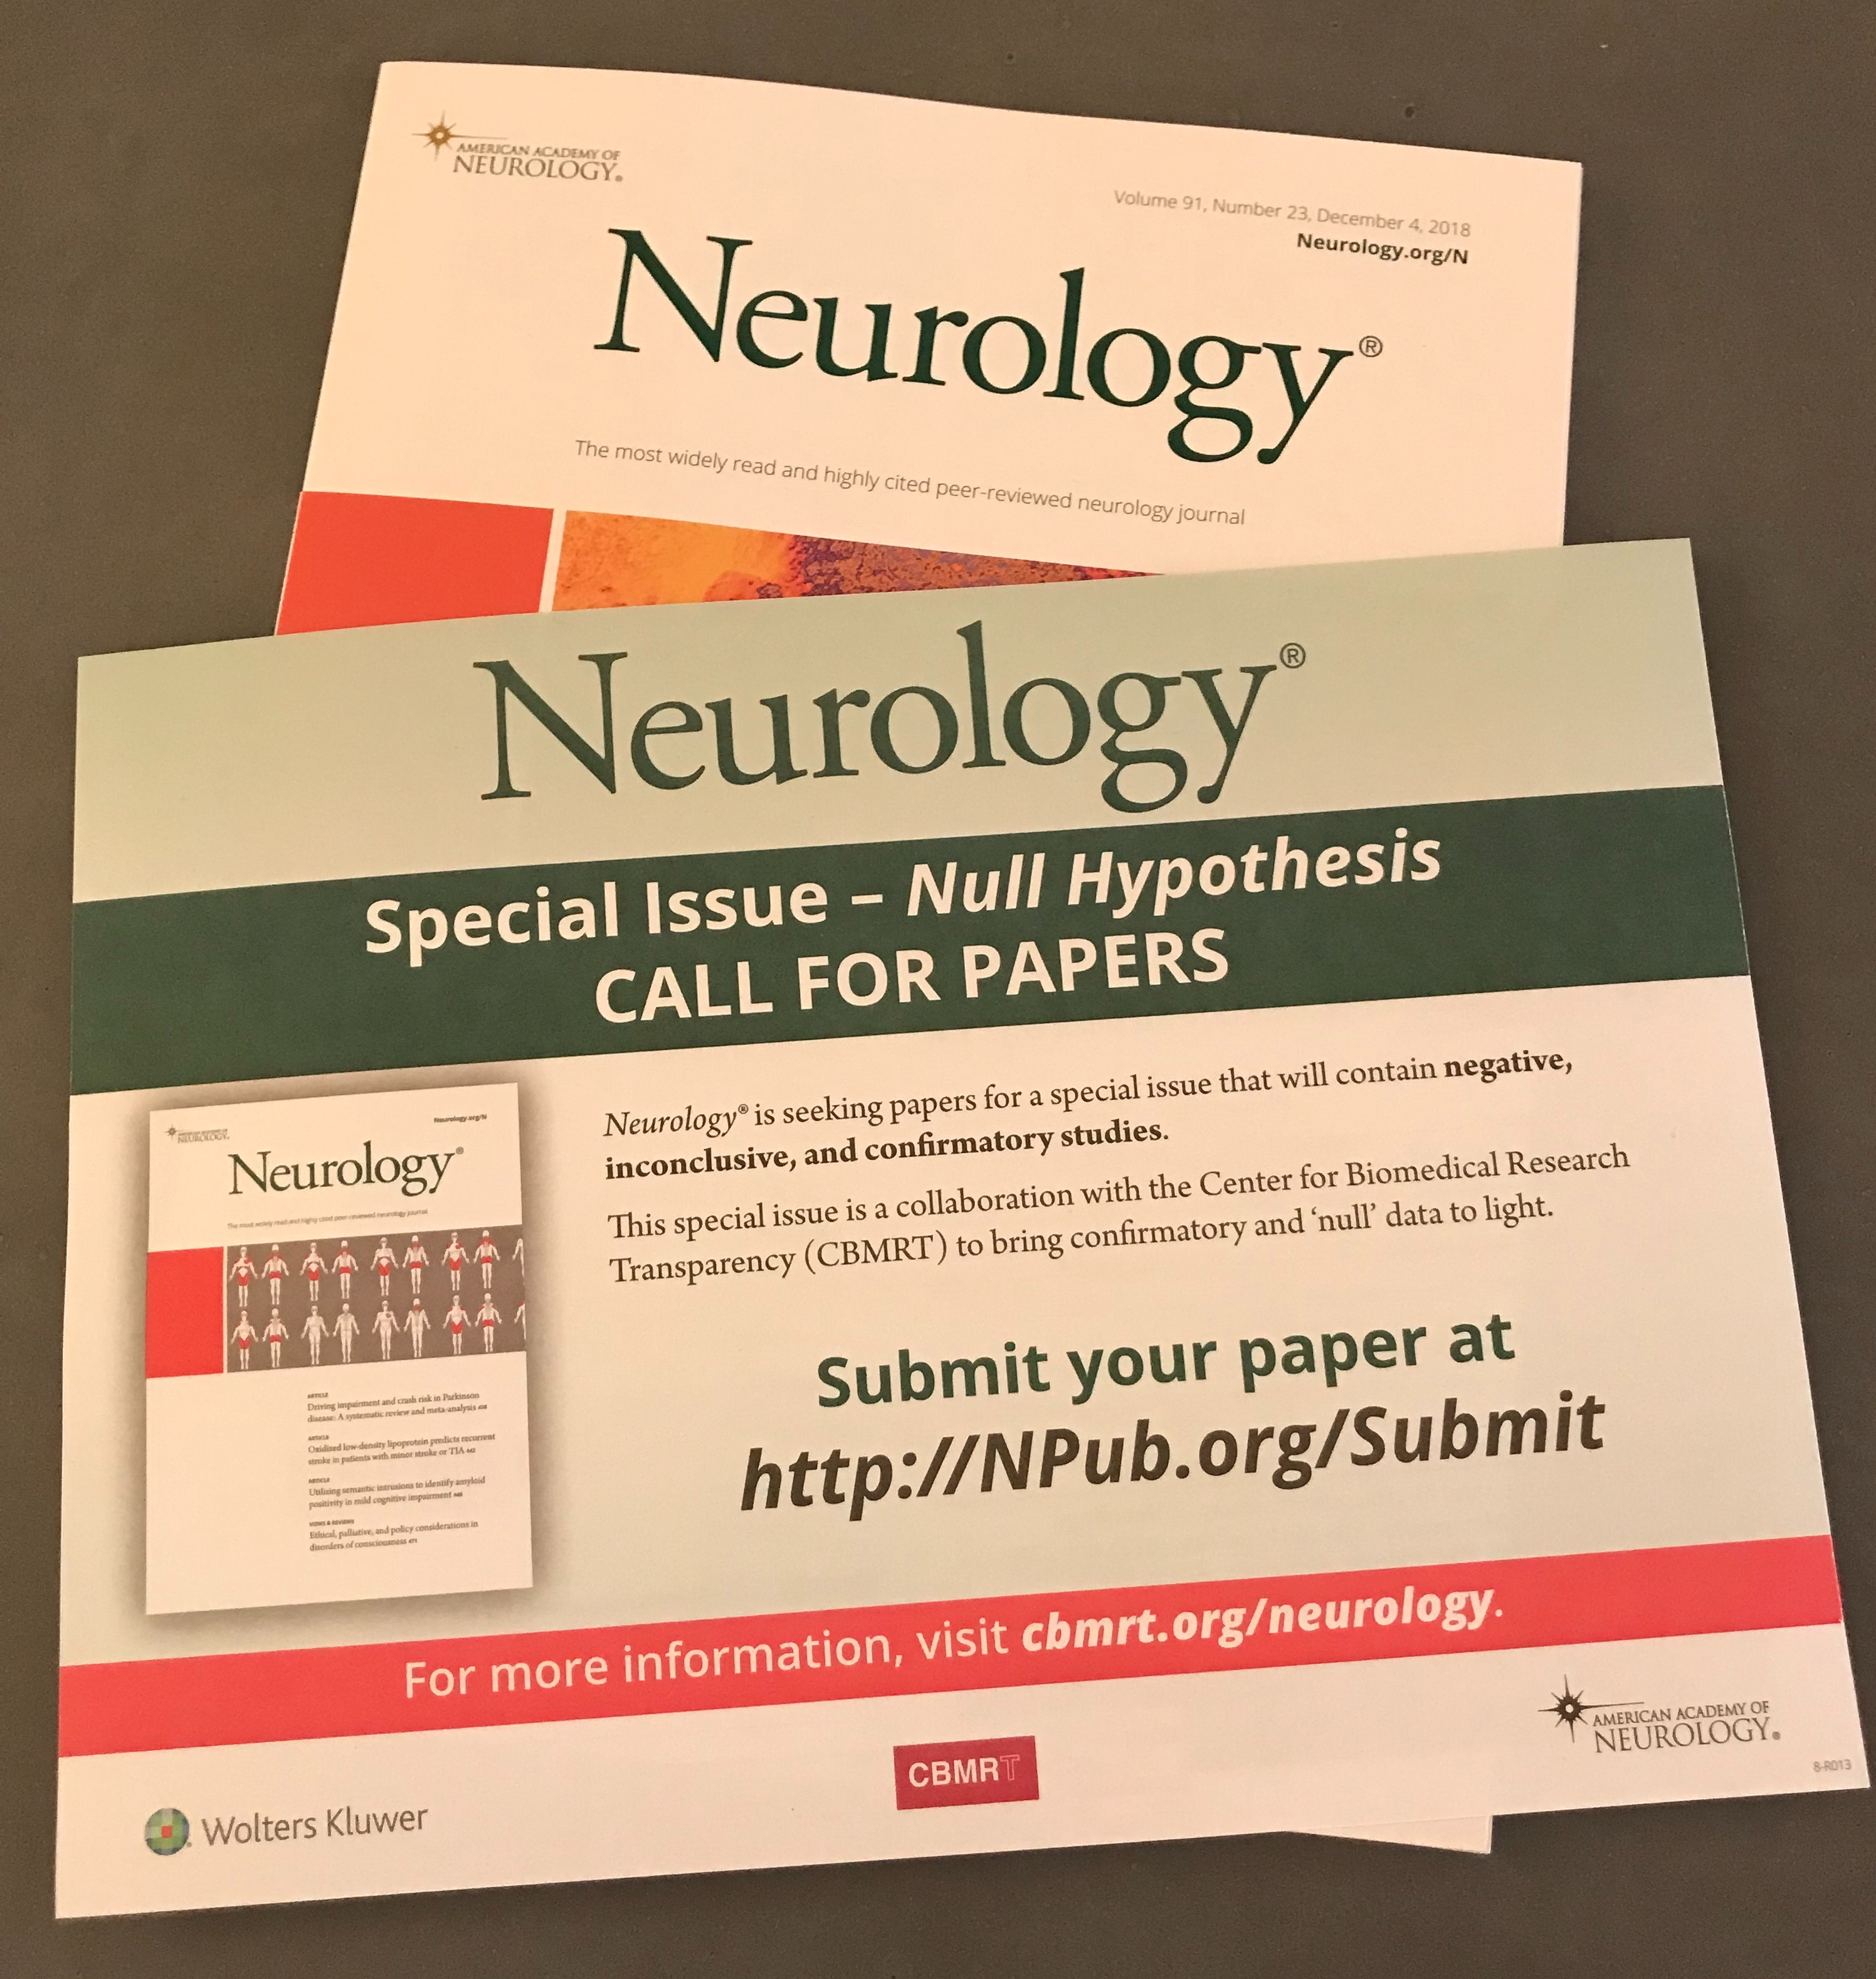
Strategy
We aim to have Neurology® Null Hypothesis arrive on the screens, kitchen table, and labs of every Neurology reader, freely available
Gain momentum, and positive press for the write-up and publication of negative, inconclusive, or replicative research studies

Slide 16
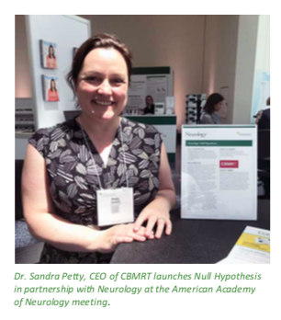
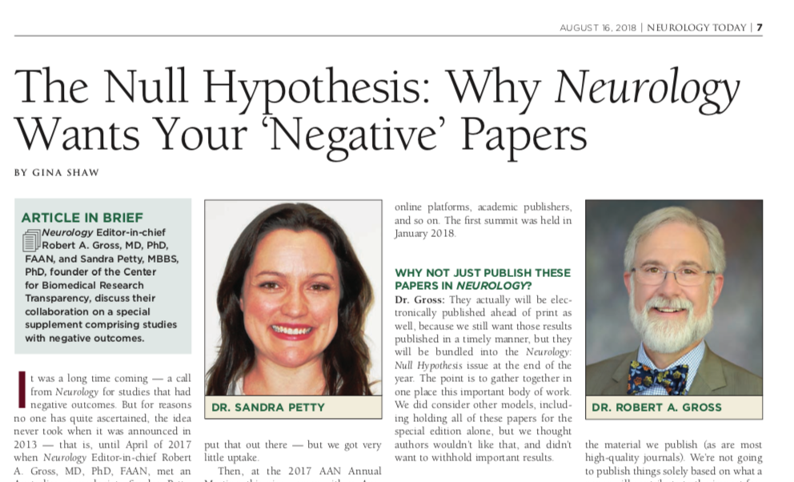
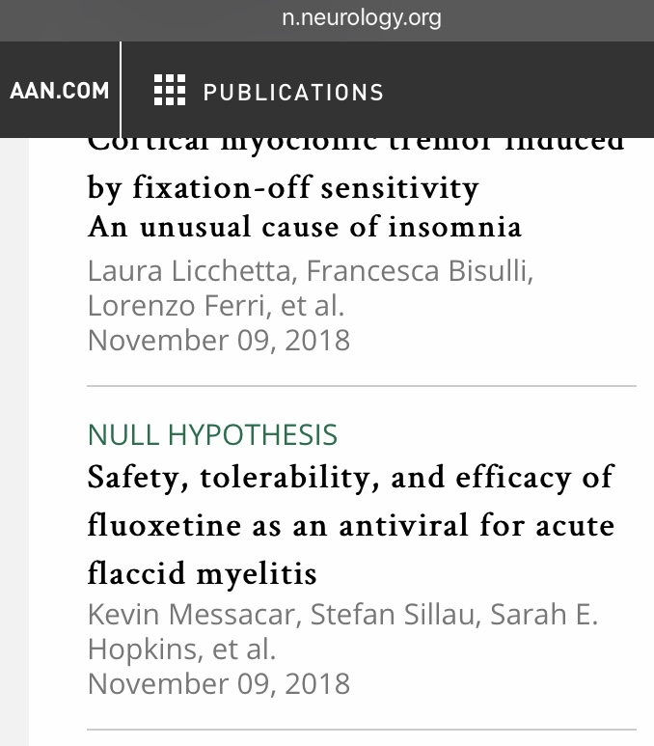
Neurology® Null Hypothesis

Slide 17
Progress
White paper submitted to Neurology in 2017
Collaboration between Neurology®, Wolters Kluwer and CBMRT
Initiative launched American Academy of Neurology meeting, 2018
Editorial Board briefed.
Information at publications booth.
Special Editorial published in Neurology® 2018
Call for papers on-line, in print and in Neurology Today®
Neurology® Null Hypothesis papers are now appearing online ahead of print on Neurology® website as they are accepted
Neurology® Null Hypothesis Special Edition will be printed.

Slide 18
Neurology® Perspective
Patty Baskin - Executive Editor, Neurology® Journals
Prof Bradford Worrell – Deputy Editor, Neurology ®
Kim Jansen - Executive Publisher, Medical Journals, Wolters Kluwer

Slide 19
Momentum!
Papers are still being submitted!
Looking at expansion to other fields
Continue to fundraise and correspond with editors, funders, publishers and societies to expand the availability of the Null Hypothesis Initiative

Slide 20
Questions
Email: sandy@cbmrt.org

Slide 21
Acknowledgements
Robert Gross – Editor-in-Chief of Neurology®
Brad Worrell – Deputy Editor Neurology®
Patty Baskin - Executive Editor, Neurology® Journals
Kim Jansen – Executive Publisher, Medical Journals - Wolters Kluwer
American Academy of Neurology
Neurology Reviewers, authors and research participants
Wolters Kluwer
CBMRT board and staff

