Slide 1
Rigor and transparency are inseparable
Disclaimer
Opinions I will voice are not official opinions of NIH
Shai D. Silberberg
National Institute of Neurological Disorders and Stroke National Institutes of Health

Slide 2
The Center for Biomedical Research Transparency (CBMRT)
“We aim to ensure that all biomedical results – including negative and inconclusive results - are accessible to researchers and clinicians in the interests of full transparency and research efficiency.”

Slide 3
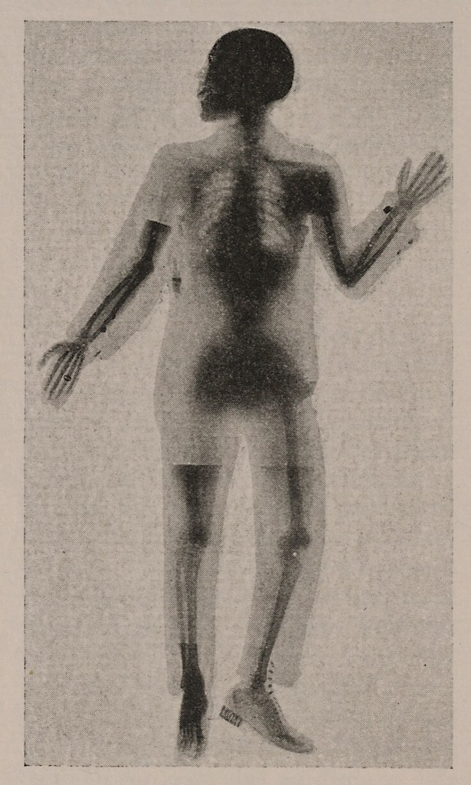
Full transparency
Reporting what was found
Neutral outcomes (publication bias)
All experiments within a study
Missed data points
Reporting what was done
Methods used
Resources
Minimizing chance observations
Measures to reduce unconscious biases
Reporting what was found
Neutral outcomes (publication bias)
All experiments within a study
Missed data points
Reporting what was done
Methods used
Resources
Minimizing chance observations
Measures to reduce unconscious biases
X-Ray of Dayton C. Miller

Slide 4
Publication Bias
Research Question
hypothesis
Experiments
to test the hypothesis


Publish!

File

Slide 5
“Publication bias in reports of animal stroke studies leads to overstatement of efficacy”
“We identified 16 systematic reviews of interventions tested in animal studies of acute ischaemic stroke involving 525 unique publications.
Only ten publications (2%) reported no significant effects on infarct volume.”
Sena et al., PLOS Biol 2010; Vol 8 Issue 3

Slide 6
Amyotrophic lateral sclerosis (ALS)
Death within 5 years of diagnosis
Rodents over-expressing SOD1 used as a model for ALS
2002: Minocycline reported to
extend survival of SOD1 mice
2003: Randomized placebo controlled trial (412 patients treated for 9 months)
2007: Results of the trial are published - minocycline found to have a harmful effect on patients with ALS
Lou Gehrig
“The Iron Horse”
1903 -1941

Slide 7
ALS Therapy Development Institute (ALS TDI)
Screened more than 70 drugs in 18000 mice across 221 studies
Used rigorous and appropriate statistical methodologies
measured a significant difference in survival between males and females with great sensitivity
No statistically significant positive (or negative) effects for any of the compounds tested, including several previously reported as efficacious.
Scott et al., Amyotroph Lateral Scler 2008; 9: 4-15

Slide 8
ALS Therapy Development Institute (ALS TDI)
“…the majority of published effects are most likely measurements of noise in the distribution of survival means as opposed to actual drug effect.“
Scott et al., Amyotroph Lateral Scler 2008; 9: 4-15

Slide 9
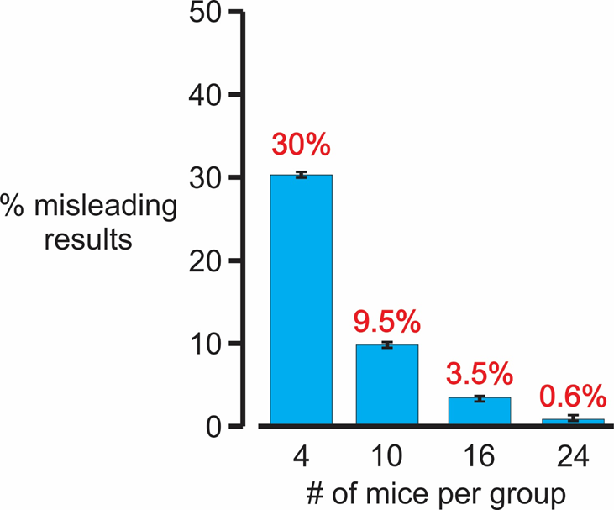
The probability of seeing an apparent effect by chance is significant even with 10 animals per group
Scott et al., Amyotroph Lateral Scler 2008; 9: 4-15

Slide 10
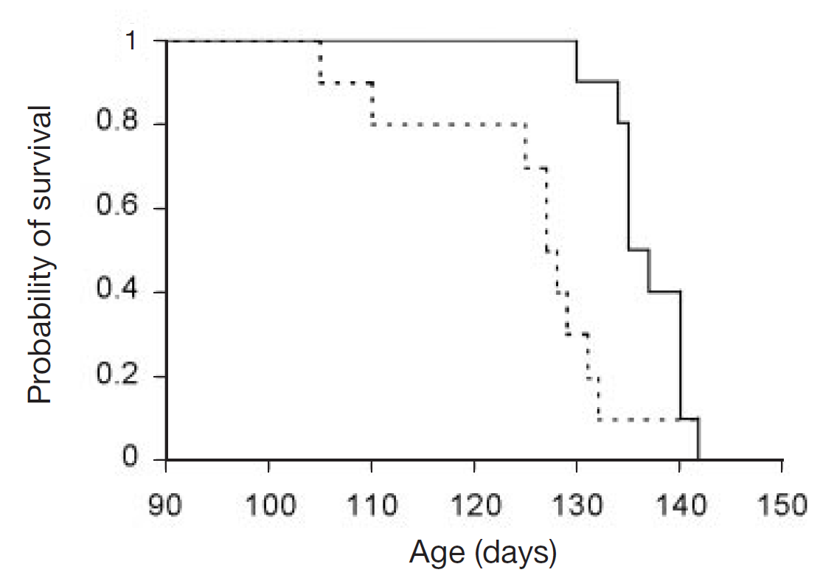
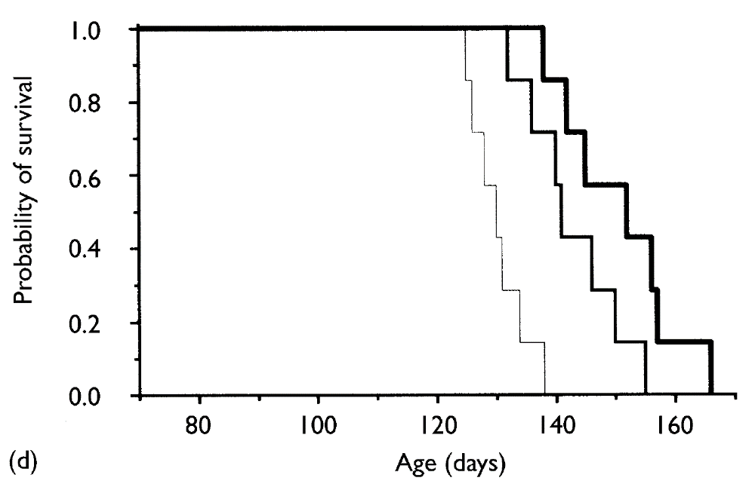
The minocycline studies
The minocycline studies might have been chance observations
SOD1^{G93A} transgenic mice
Started at 5 weeks of age
i.p. 10mg/kg/day
10 animals / group (sex?)
SOD1^{G93A} transgenic mice
Started at 10 weeks of age
i.p. 25 and 50 mg/kg/day
7 animals / group (females)

Slide 11
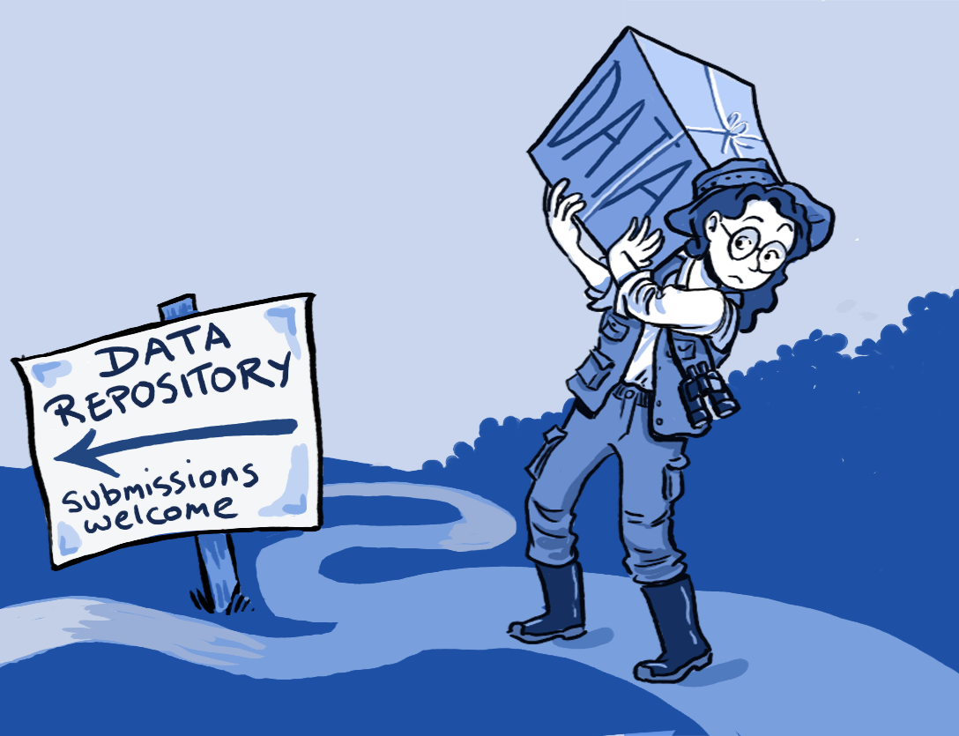
Rigor and transparency are inseparable
Reporting what was found
Neutral outcomes (publication bias)
All experiments within a study
Missed data points
Reporting what was done
Methods used
Resources
Minimizing chance observations
Measures to reduce unconscious biases
Reporting what was found
Neutral outcomes (publication bias)
All experiments within a study
Missed data points
Reporting what was done
Methods used
Resources
Minimizing chance observations
Measures to reduce unconscious biases
Wikimedia Commons
Illustration credit: Ainsley Seago

Slide 12
Human Nature
“Once a man’s understanding has settled on something (….), it draws everything else also to support and agree with it”
The New Organon, 1620
Unconscious Bias
FRANCIS BACON

Slide 13
“I used to think that the brain was the most wonderful organ in my body. Then I realized who was telling me this.”
Emo Phillips
licensed under
the Creative Commons Attribution-Share Alike 3.0 Unported license

Slide 14
The definition of experimental bias
“The reliability of a study is determined by the investigator’s choices about critical details of research design and conduct”
“Bias is unintentional and unconscious”
“…..The process of addressing bias involves making everything equal during the design, conduct and interpretation of a study, and reporting those steps in an explicit and transparent way.”
David F. Ransohoff, 2005. Nature Reviews Cancer 5: 142-149

Slide 15
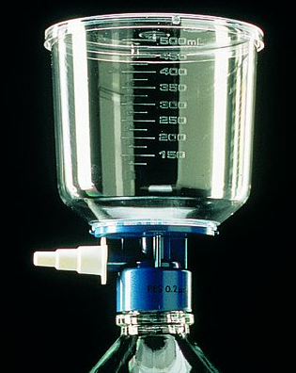
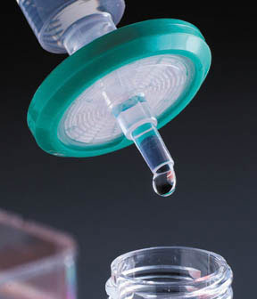
Unforeseen experimental bias
Lee et al., 2015. J Neurochem 133: 53-65

Slide 16
The minocycline studies
The minocycline studies might not have been randomized
SOD1^{G93A} transgenic mice
Started at 5 weeks of age
i.p. 10mg/kg/day
No mention of randomization
SOD1^{G93A} transgenic mice
Started at 10 weeks of age
i.p. 25 and 50 mg/kg/day
No mention of randomization

Slide 17
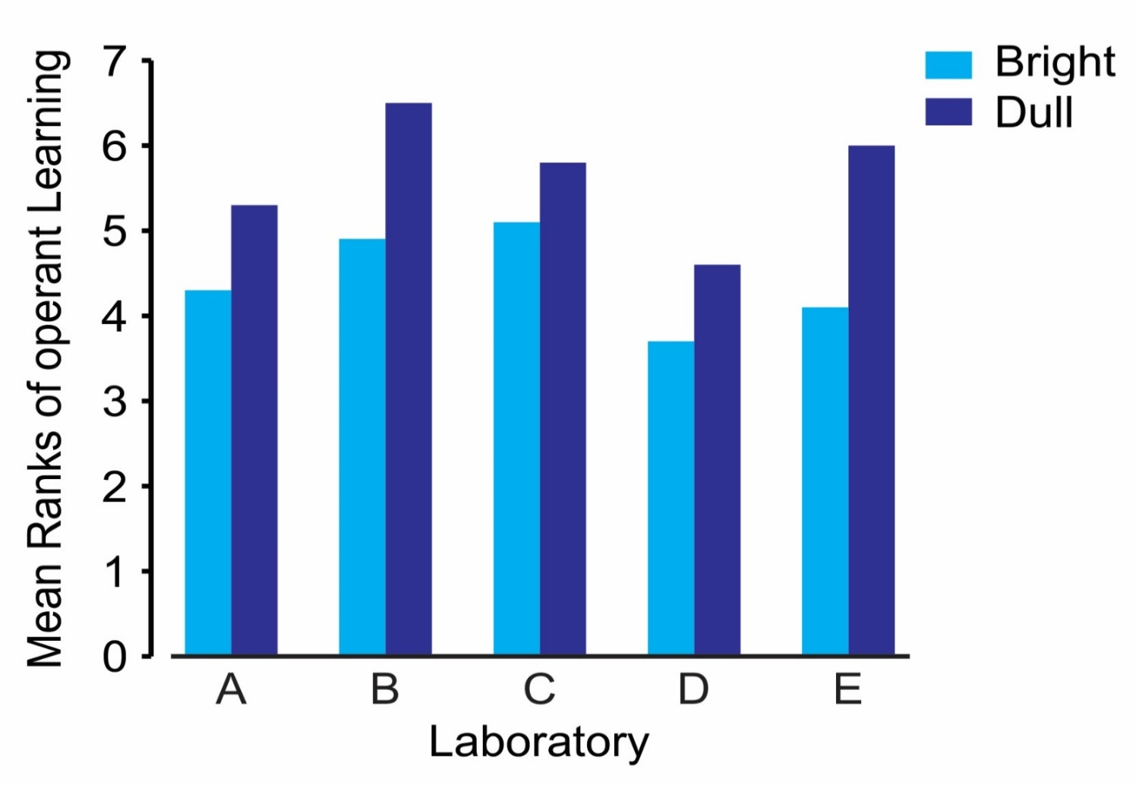
Expectation bias
14 Rodents
39 Homo sapiens
Rosenthal and Lawson, J. Psychiat. Res.1964; 2: 61-72

Slide 18
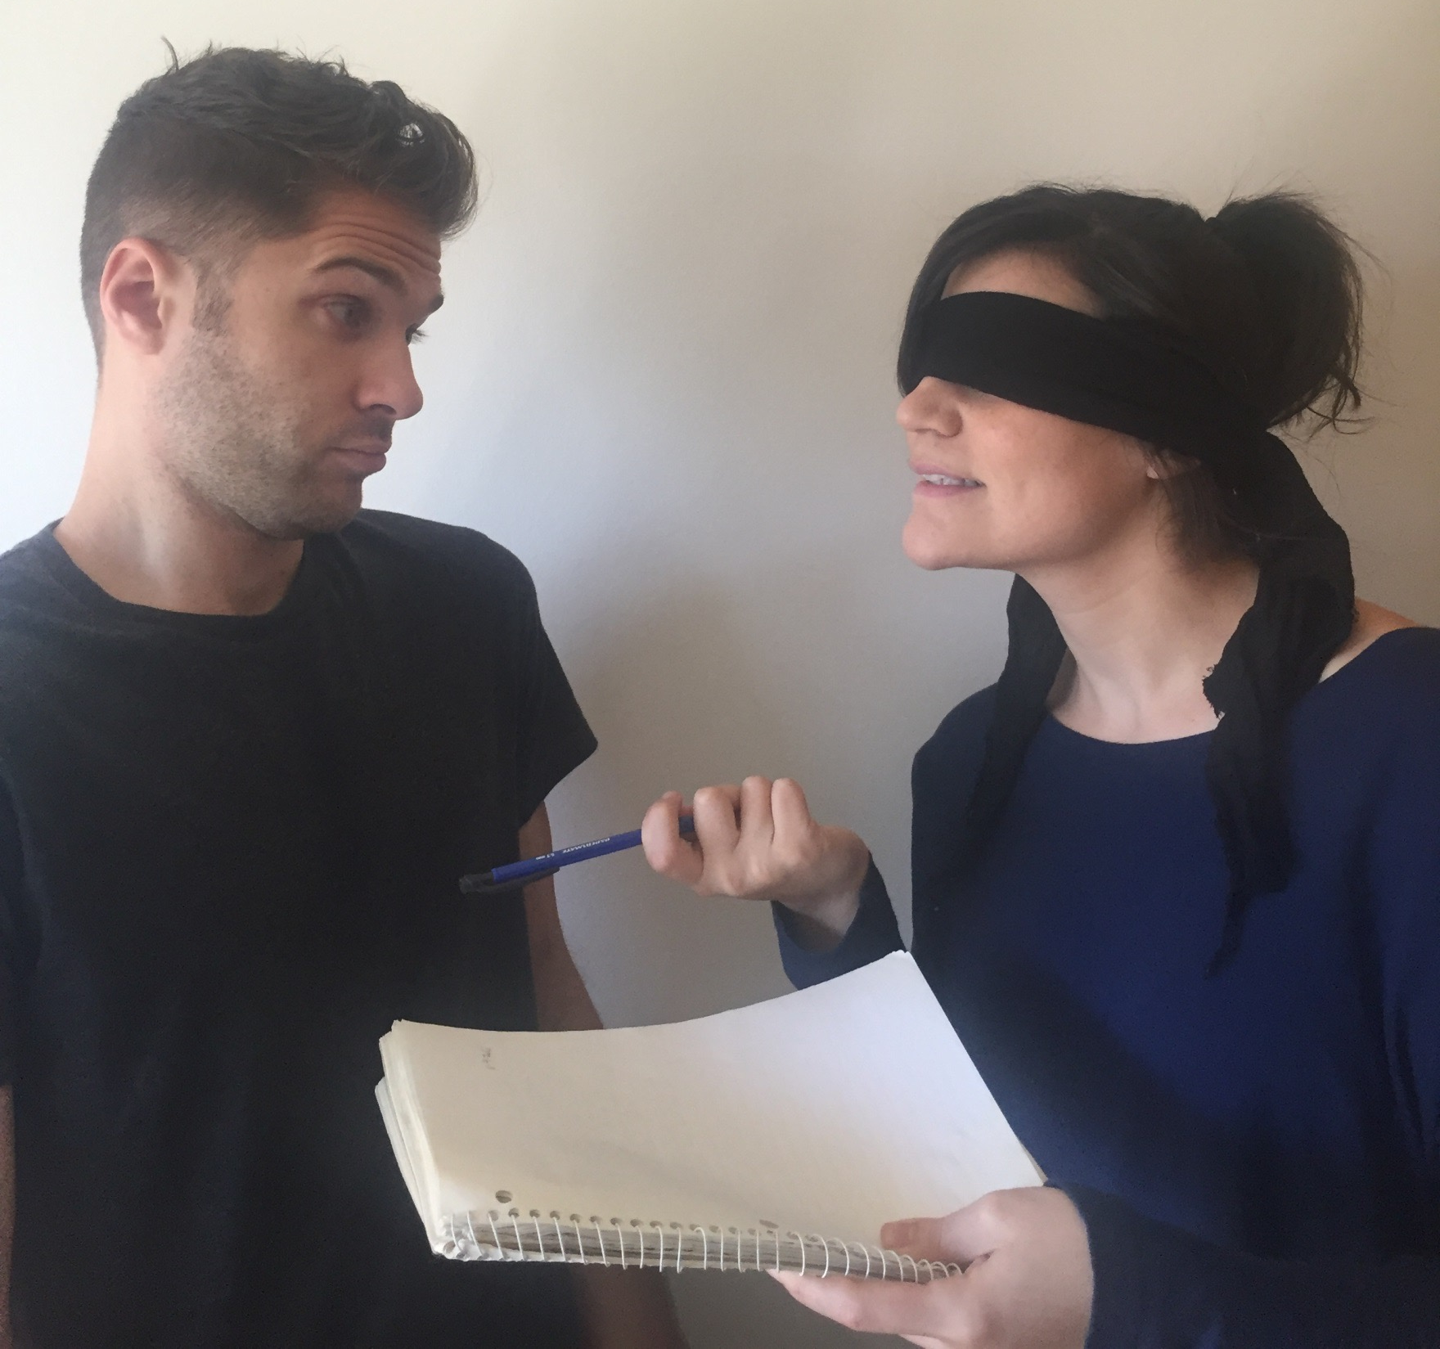
In many cases, blinding is not difficult to achieve

Slide 19
Small sample sizes and/or bias might have led to the apparent survival benefit of minocycline in the SOD1^{G93A} mice
No mention of blinding
“The experimenter was blinded to the treatment protocol.”

Slide 20
Insufficient reporting of methodological approaches is evident for pre-clinical studies
MS 1117 178 (16%) 106 (9%) 2 (<1%)
Sena et al., JCBFM. 2014; 34: 737-742

Slide 21
The fewer methodological parameters are reported, the greater the apparent efficacy!
Effect size for studies of FK506 (Tacrolimus) in experimental stroke.
Sena et al., Trends Neurosci 2007; 30: 433-439

Slide 22
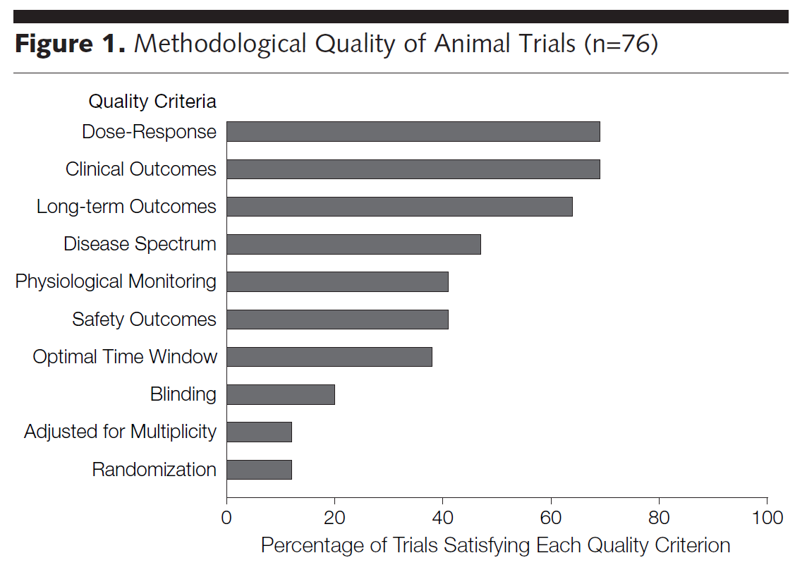
Inadequate reporting is widespread
Journals:
Cell
Nature
Science
Nature Medicine
Nature Genetics
Nature Immunology
Nature Biotechnology
>500 citations
Hackam and Redelmeier, JAMA 2006; 14: 1731-1732

Slide 23
Peer Review
“Peer review is the evaluation of work by one or more people of similar competence to the producers of the work.”
Wikipedia

Slide 24
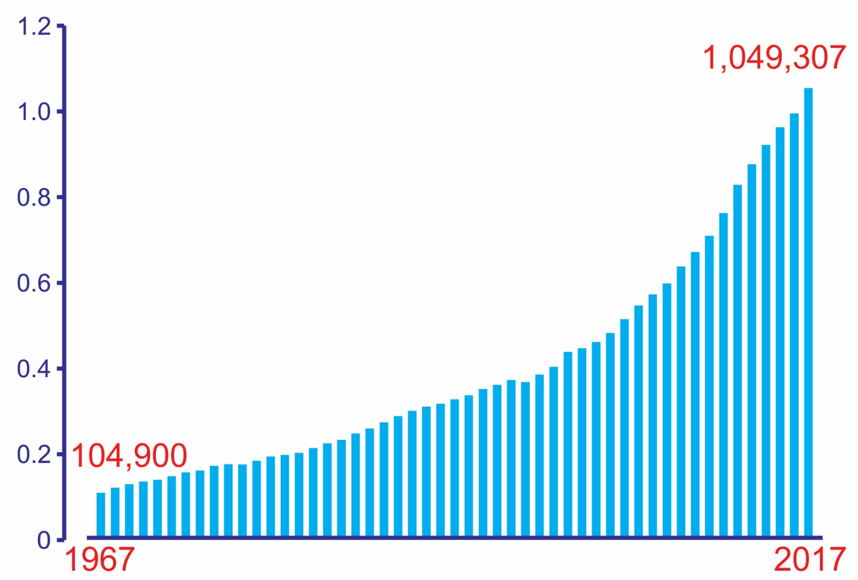
The Escalation in Scientific Reporting
(Annual PubMed journal articles in English)
Pubs
(x10⁶)
“The number of journals has behaved just like a colony of rabbits breeding among themselves and reproducing every so often.”
Derek de Solla Price
1975 (1961)
Year

Slide 25
Paper money!
Publish or perish!
Impact factor
Grant support
Novelty
Significance
Innovation

Slide 26
How to improve rigor and transparency?
Lack of transparency in reporting
Review
Transparency
in reporting
Notes:
26

Slide 27
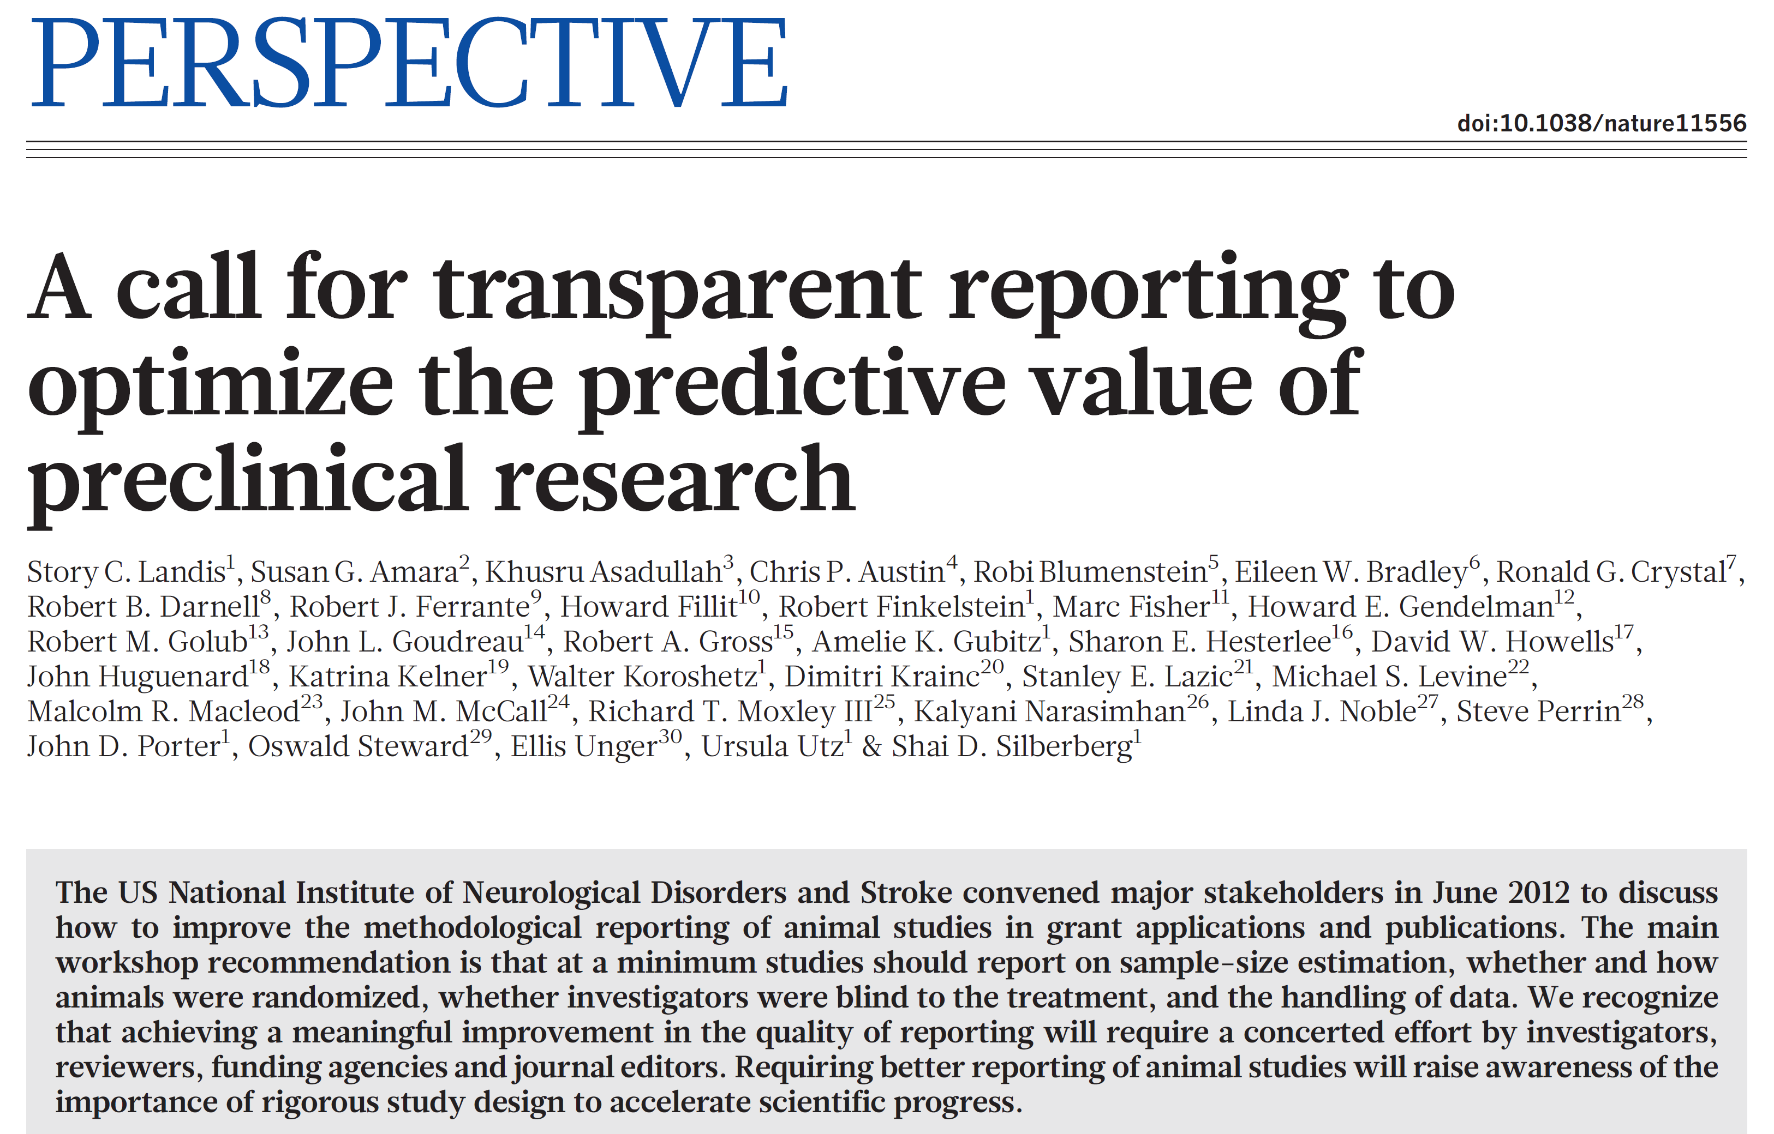
Landis, et al., Nature 2012; 490: 187-191

Slide 28
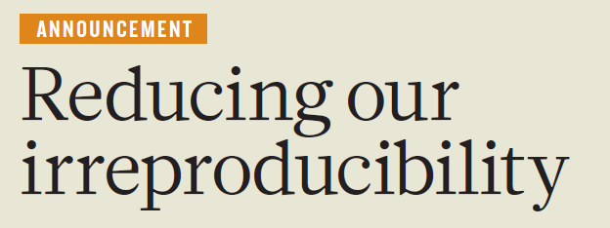
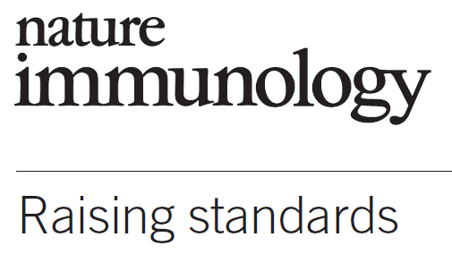
“…we will more systematically ensure that key methodological details are reported, and we will give more space to methods sections. We will examine statistics more closely and encourage authors to be transparent, for example by including their raw data.”

Slide 29
Completeness of reporting before ( ) and after ( ) change in Nature journals’ editorial policy
bioRxiv , Sep. 12, 2017; http://dx.doi.org/10.1101/187245.

Slide 30
What about grant review at NIH?

Slide 31
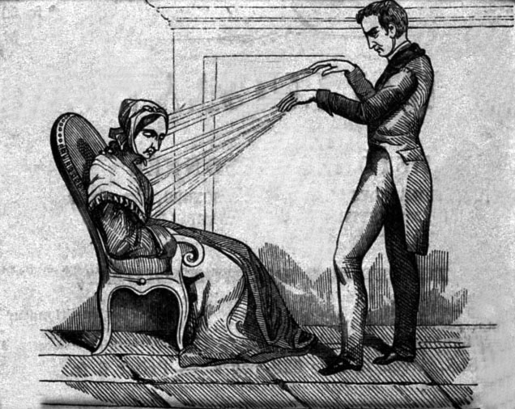
Rigorous Experimental Design for robust and unbiased results
NIH expects full transparency in proposing and reporting experimental details so that reviewers may assess the proposed research and others may reproduce and extend the findings.
Animal Magnetism
Friedrich Anton Mesmer
https://grants.nih.gov/policy/reproducibility/guidance.htm

Slide 32
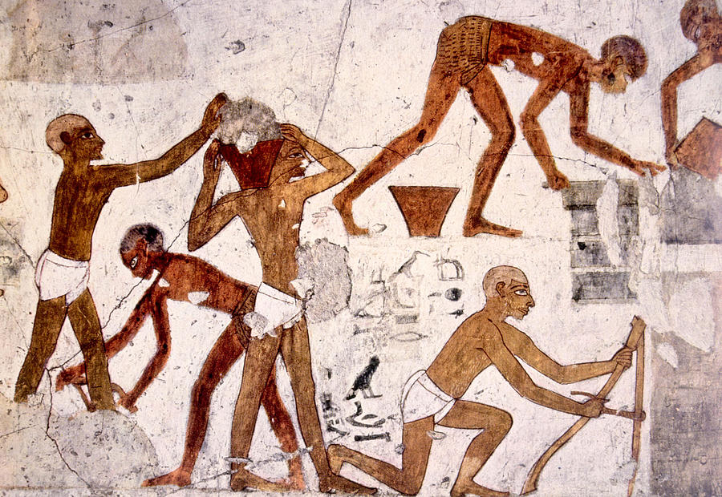
The rigor of the prior research
NIH expects applicants to describe the general strengths and weaknesses in the rigor of the prior research (both published and unpublished) that serves as the key support for the proposed project.
https://grants.nih.gov/policy/reproducibility/guidance.htm

Slide 33
How to improve rigor and transparency?
Lack of transparency in reporting
Review
Transparency
in reporting
Unconscious bias;
Deficient experimental procedures
Education
Attentiveness to bias; Good experimental design
Publication bias
Culture
Focus on rigor not glitter
Notes:
33

Slide 34
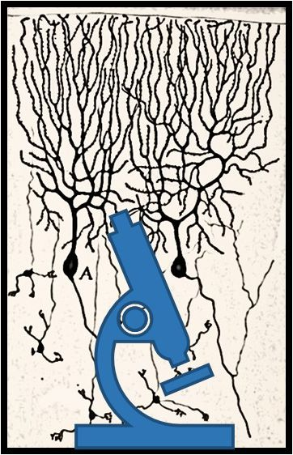
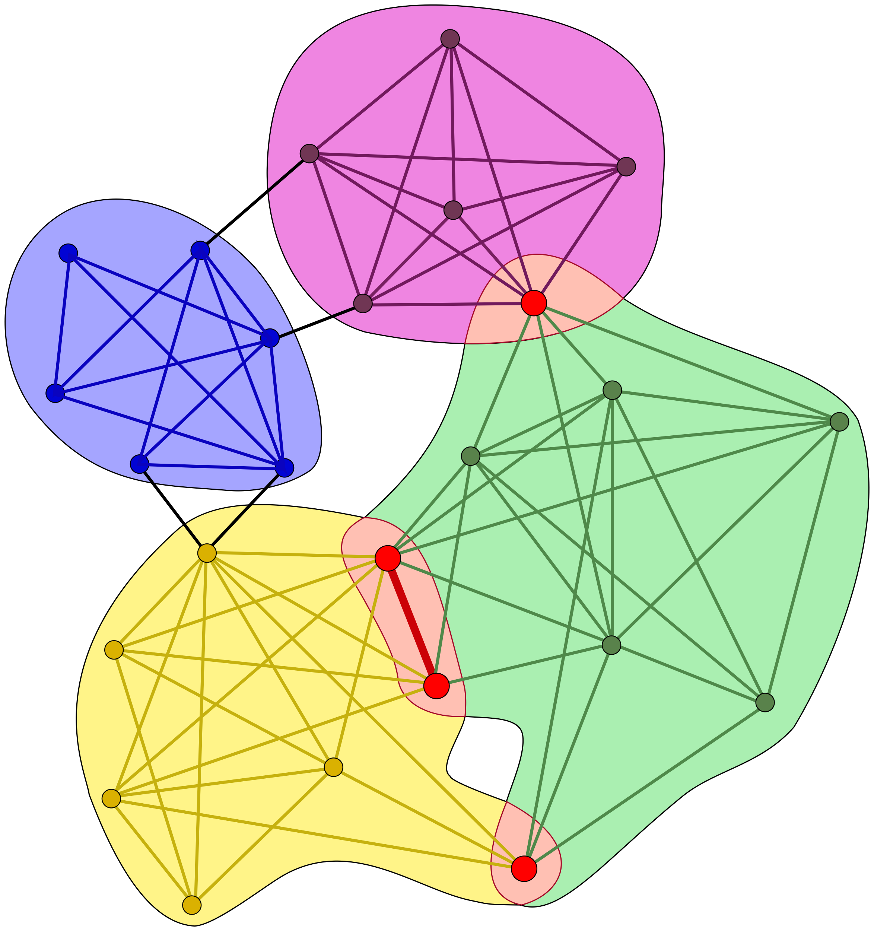
A Visionary Resource for Instilling Fundamental Principles of Rigorous Neuroscience Research October 22 – 23, 2018
An effective educational platform should target all career stages
Interventions need to lead to behavioral change
Progress will require a culture change at all academic, publishing, and funding organizational levels
Academic institutions need to play a proactive role in changing the culture
Call to establish communities of champions

Slide 35
Rigor and transparency are inseparable
“If you’re doing an experiment, you should report everything that you think might make it invalid – not only what you think is right about it….
Details that could throw doubt on your interpretation must be given, if you know them. You must do the best you can – if you know anything at all wrong, or possibly wrong – to explain it.”

