Slide 2
ALLTRIALS CAMPAIGN:
MORE PEOPLE ARE MONITORING CLINICAL TRIAL RESULTS REPORTING THAN YOU MGHT THINK
Síle Lane
Head of international campaigns and policy Sense about Science
@senseaboutsci #AllTrials

Slide 3
Notes:
Around half of clinical trials conducted on treatments we use today have never published results. We don’t know what was discovered in those trials, which means doctors can’t assess the best choices for patients, and researchers are missing vital information and wasting time and money. And the trust of millions of volunteers in trials - that the findings are used to improve treatments – is being undermined.

Slide 4
All Trials Registered | All Results Reported
Notes:
The problems of publication bias and lack of transparency in clinical research has been talked about for more 30 years.
But nothing changed until people outside of academics started talking about it.
Our aim when we launched AllTrials, the campaign for all clinical trials to be registered and results reported in 2013.
We at SaS along with Ben G, BMJ, PLOS, Cochrane Collaboration, Centre for Evidence-Based Medicine at Oxford University founding groups.
Pull in new voices
Show that all sorts of people care about this and that new people joining the call for change
So that authorities, companies, academics feel the pressure to react.

Slide 5
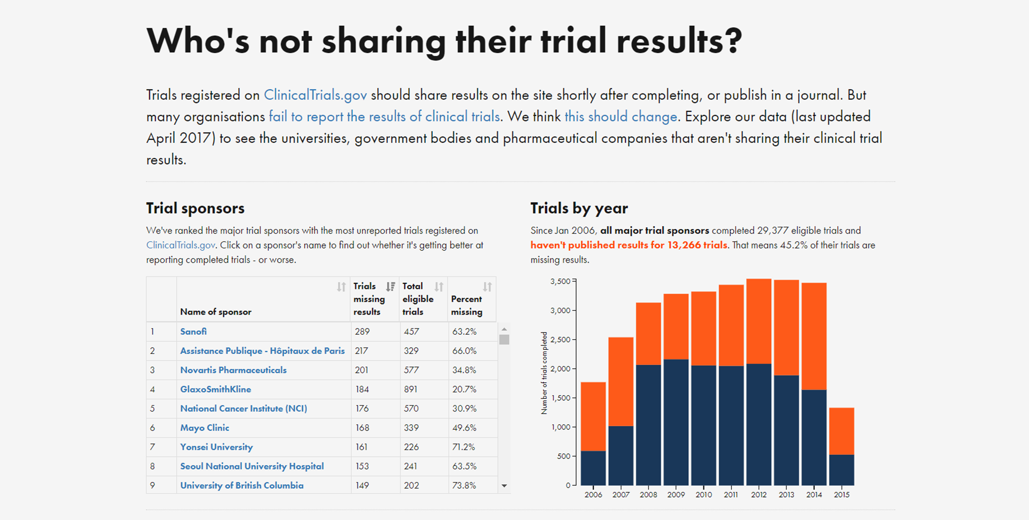
TrialsTracker
https://trialstracker.ebmdatalab.net/#/

Slide 6
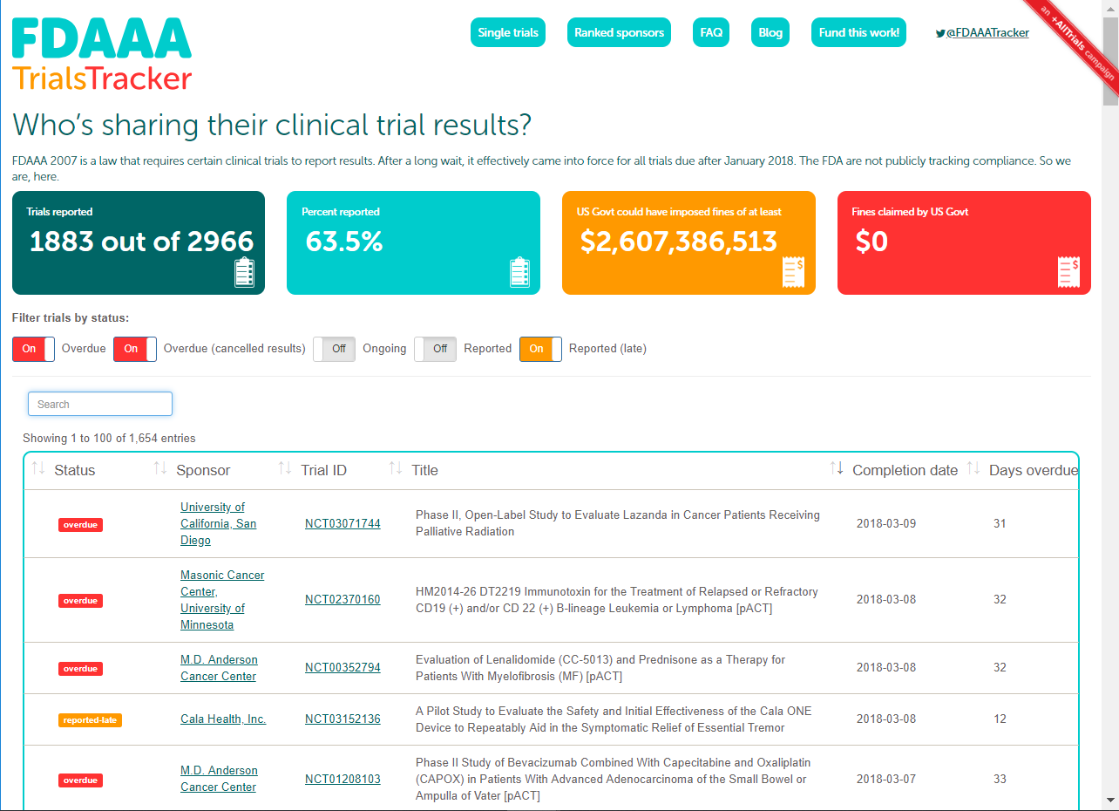
https://fdaaa.trialstracker.net/

Slide 7
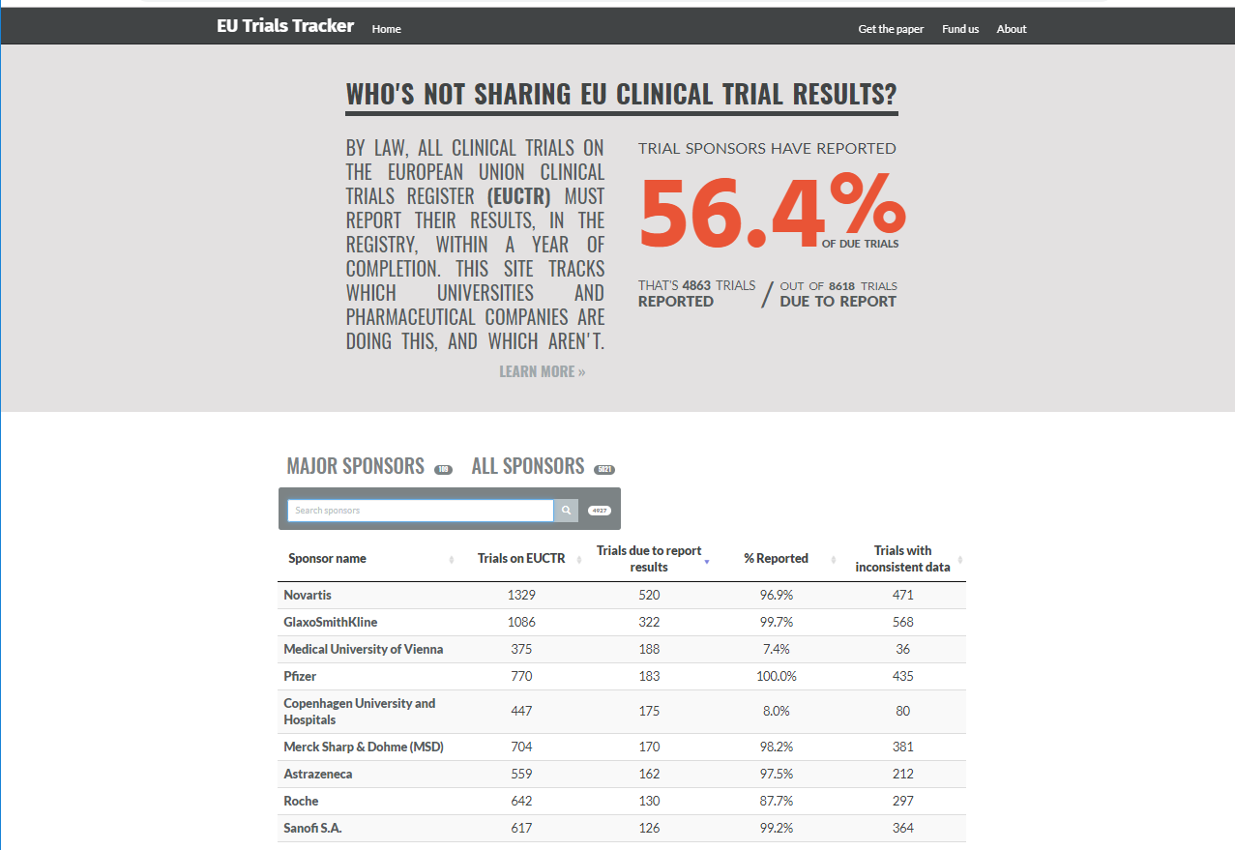
https://eutrialstracker.ebmdatalab.net/
Notes:
Tracker for clinical trials on the EU register
56% of trials that should have had results reported onto the register have been reported.
Trackers allows us to see sponsors too, so looking into types of sponsor
68% of company-sponsored trials that are due to report results onto the register have but only 11% of academic trials have.
UCH Galway?

Slide 8
Investment groups worth more than €3.5 trillion support clinical trial transparency
Notes:
Why are companies doing it?
To prevent further deaths and suffering
To achieve better outcomes
To protect their revenues
To demonstrate responsibility
To protect or bolster their reputations
To help recruit and retain the best scientists
To support healthcare systems

Slide 9
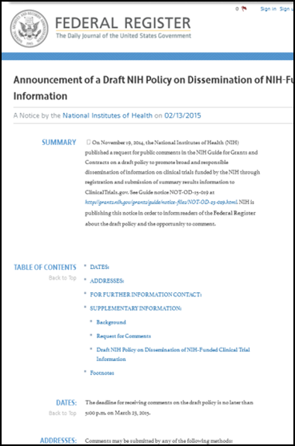
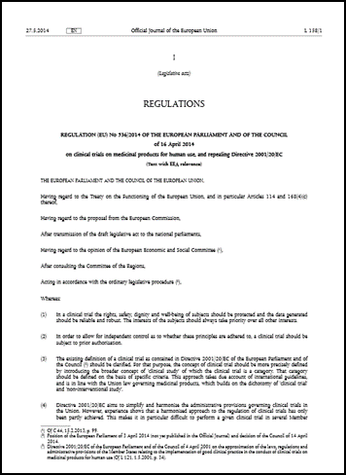

Slide 10
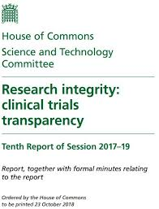
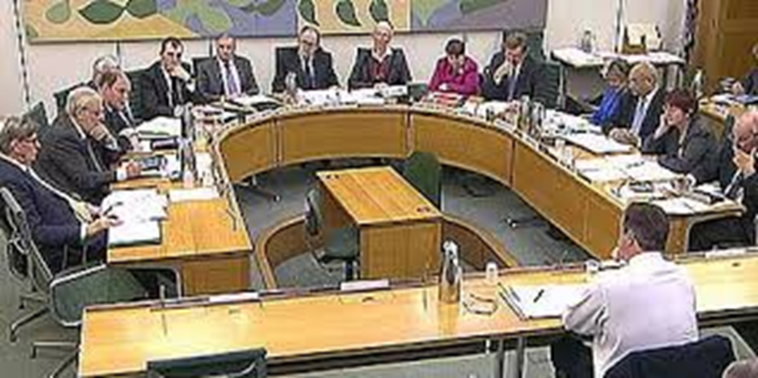

Slide 11
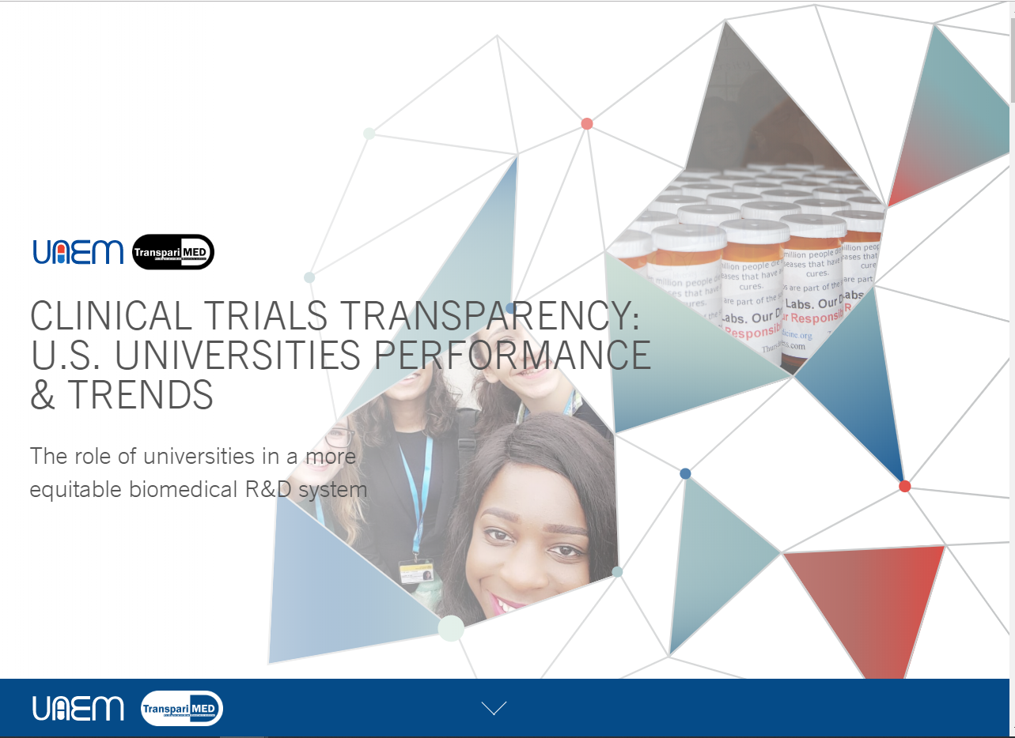
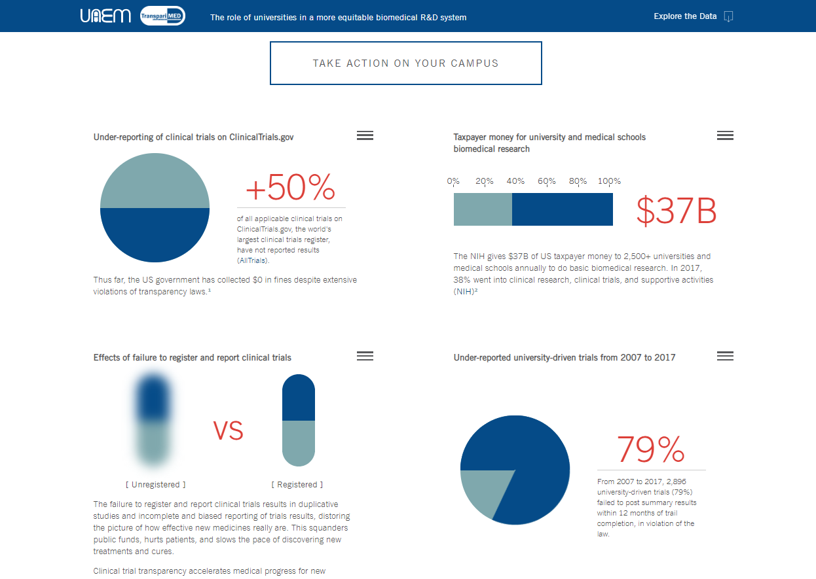

Slide 12
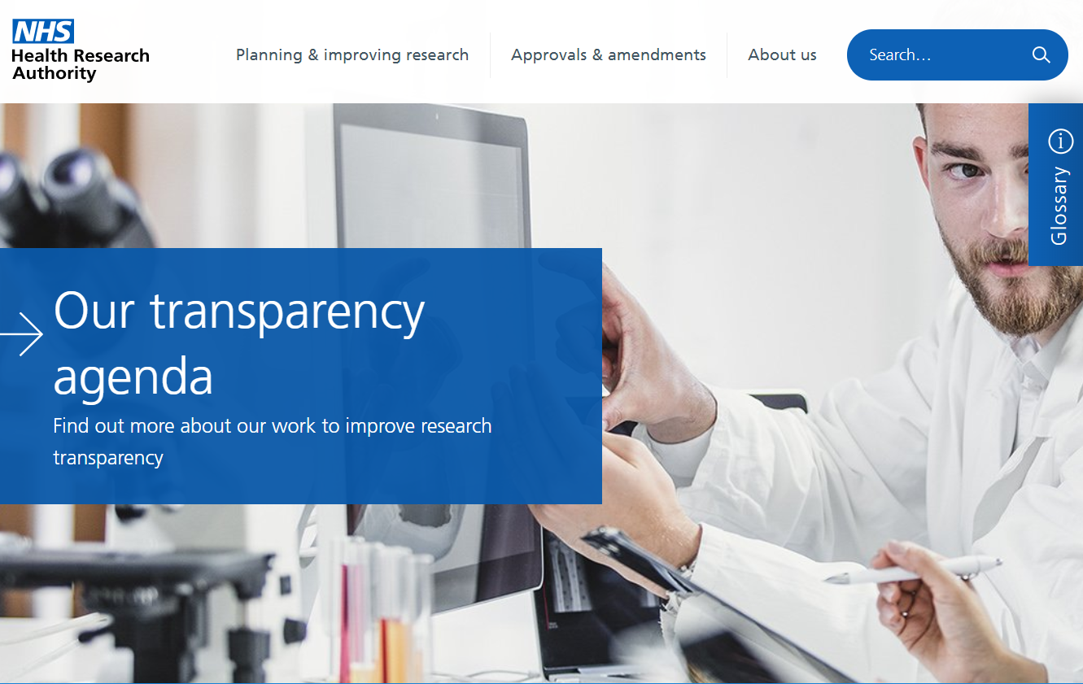

Slide 15
Notes:
We’ve had an impact – AllTrials - done a lot to make this an issue. How have we done it? By generating publicity, publishing reports, challenging regulators, meeting with companies and agitating for new practices in large research funders, trial centers and professional and ethics bodies.
Now we have turn that impact into results – need to get more clinical trial results reported.
Getting urgent as every day people and software retire.

Slide 16
ALLTRIALS CAMPAIGN:
MORE PEOPLE ARE MONITORING CLINICAL TRIAL RESULTS REPORTING THAN YOU MGHT THINK
Síle Lane
Head of international campaigns and policy Sense about Science
@senseaboutsci #AllTrials

