Slide 1
Transparency and Medical Journals
Howard Bauchner, MD
Editor in Chief, JAMA and the JAMA Network
Senior Vice-President, American Medical Association
(Nothing to Declare)

Slide 2
Transparency
Lab-based science
Clinical research
Reproducibility (ensuring accuracy)
Re-analysis (data-sharing) - maximizing benefit from studies, faithful to SAP, protocol
Benefits who - investigators, patients, industry?

Slide 3
The Role of Journals
Methodologic rigor - standards
RCTs – trial registration, publication of SAPs and protocols
Data-sharing - RCTs
Corrections, retractions, retractions with replacement

Slide 4
Study types and reporting guidelines
Randomized clinical trial
Cohort, Case-control, Cross-sectional study
Meta-analysis
Economic evaluation
Comparative effectiveness research
Genetic association study
Diagnostic/prognostic study
Quality improvement study
Survey study
Qualitative study
CONSORT
STROBE
PRISMA, MOOSE
CHEERS
ISPOR
STREGA
STARD, TRIPOD
SQUIRE
AAPOR
SRQR, COREQ
See JAMA Network Open Instructions for Authors for complete list
https://jamanetwork.com/journals/jamanetworkopen/pages/instructions-for-authors

Slide 5
Clarifications & Errors in Articles
Clarifications - letters to the editor (~90/year)
Corrections (~70/year)
Retractions (varies year to year)
Retractions with replacements

Slide 6
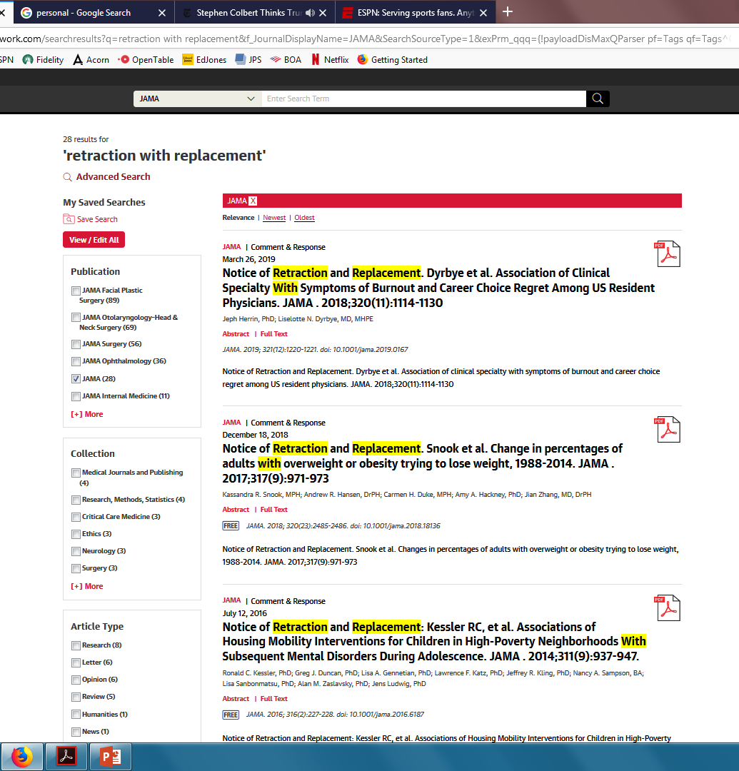
Retraction & Replacement
Introduced in 2015 (~ 4/year)
Goal – destigmatize major errors – supports accuracy and transparency
Major errors (often coding; usually detected by authors)
Conclusions change
Still considered valuable to publish

Slide 7
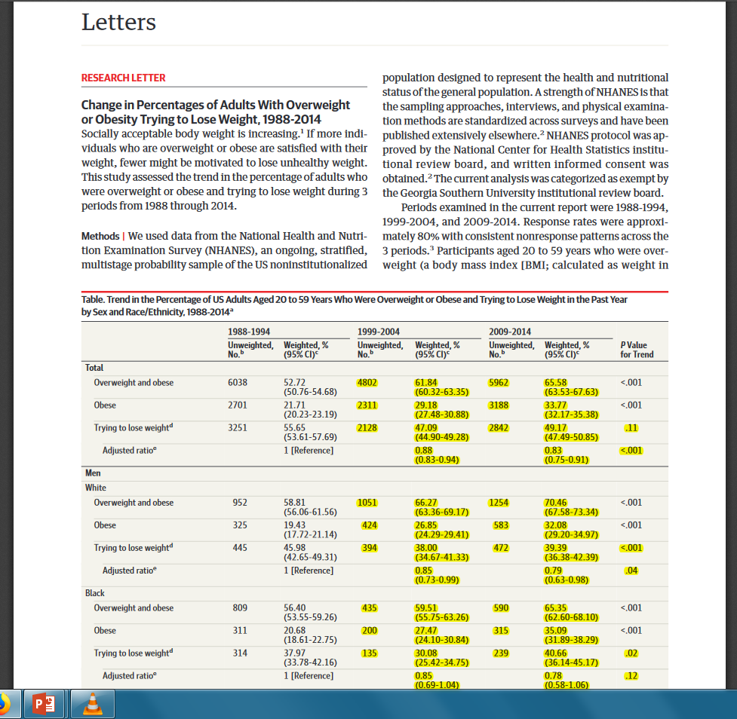
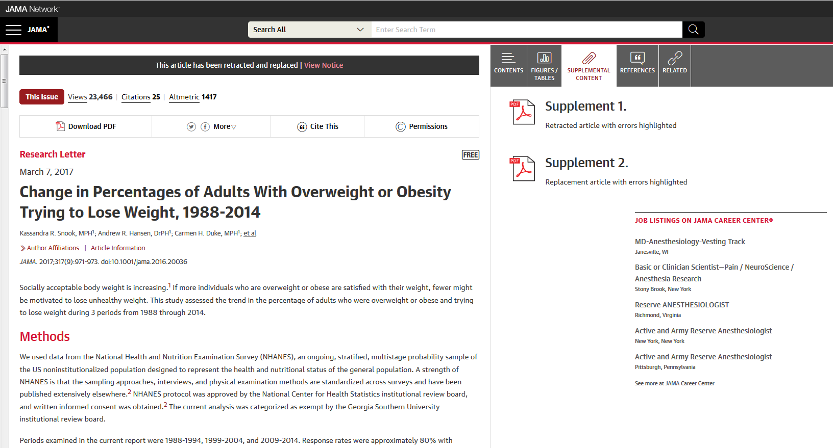

Slide 8
The Challenges of Sharing Data in an Era of Politicized Science
“Above all, the scientific process-including original research and reanalysis of shared data – must prevail, and the inherent search for evidence, facts, and truth must not be comprised by special interests, coercive influences, or politicized perspectives.”
- Howard Bauchner, Phil Fontanarosa
“The goal of making science more transparent – sharing data, posting results on trial registries, use of preprint servers, and open access publishing – may enhance scientific discovery and improve individual and population health, but it also comes with substantial challenges in an era of politicized science, enhanced skepticism, and the ubiquitous world of social media.”
“It has become increasingly clear that social media, in ways not considered when it first emerged as a new form of communication can be used (and at times is used) to manipulate thought, ideas, and beliefs.”

Slide 9
Transparency – unanswered questions
Who is this for?
What is the focus?
What is the benefit?
What is the cost?

Slide 10

Research meeting - promotes new research into the quality and credibility of peer review and scientific publication
Held every 4 years since 1989
Next: September 12-14, 2021, in Chicago
Call for Research - new studies into the processes used by researchers, authors, editors, peer reviewers, publishers, funders, universities, and any other stakeholders to improve the conduct, reporting, quality, integrity, and dissemination of scientific research

