Slide 1
The Null Hypothesis Initiative
A/Prof Sandra Petty
CEO - Center for Biomedical Research Transparency
CBMRT
175 Varick St, New York, NY 10014
Skype: +1 973 259 6536
Sandy@cbmrt.org

Slide 2
Affiliations
CEO – Center for Biomedical Research Transparency, NY, USA
Neurologist – Alfred Hospital and St Vincent’s Hospital, Melbourne Australia.
Adjunct Senior Lecturer – Monash University
Director – Brain Foundation of Victoria.
No current financial conflicts of interest.

Slide 3
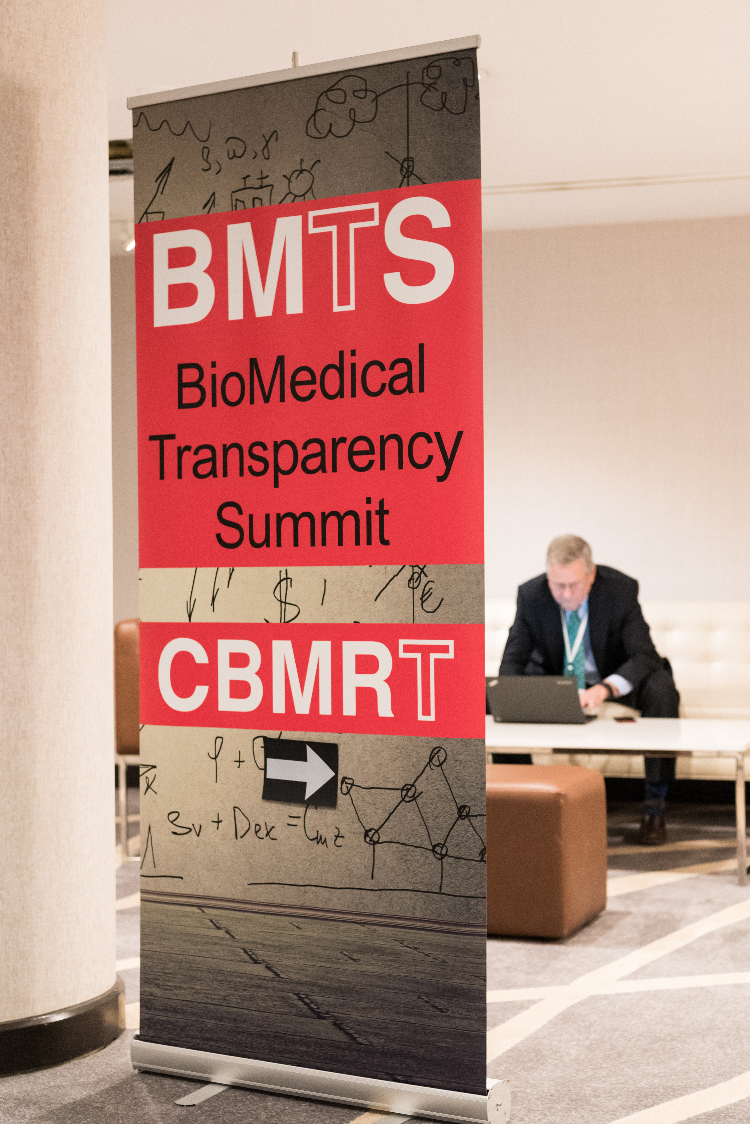
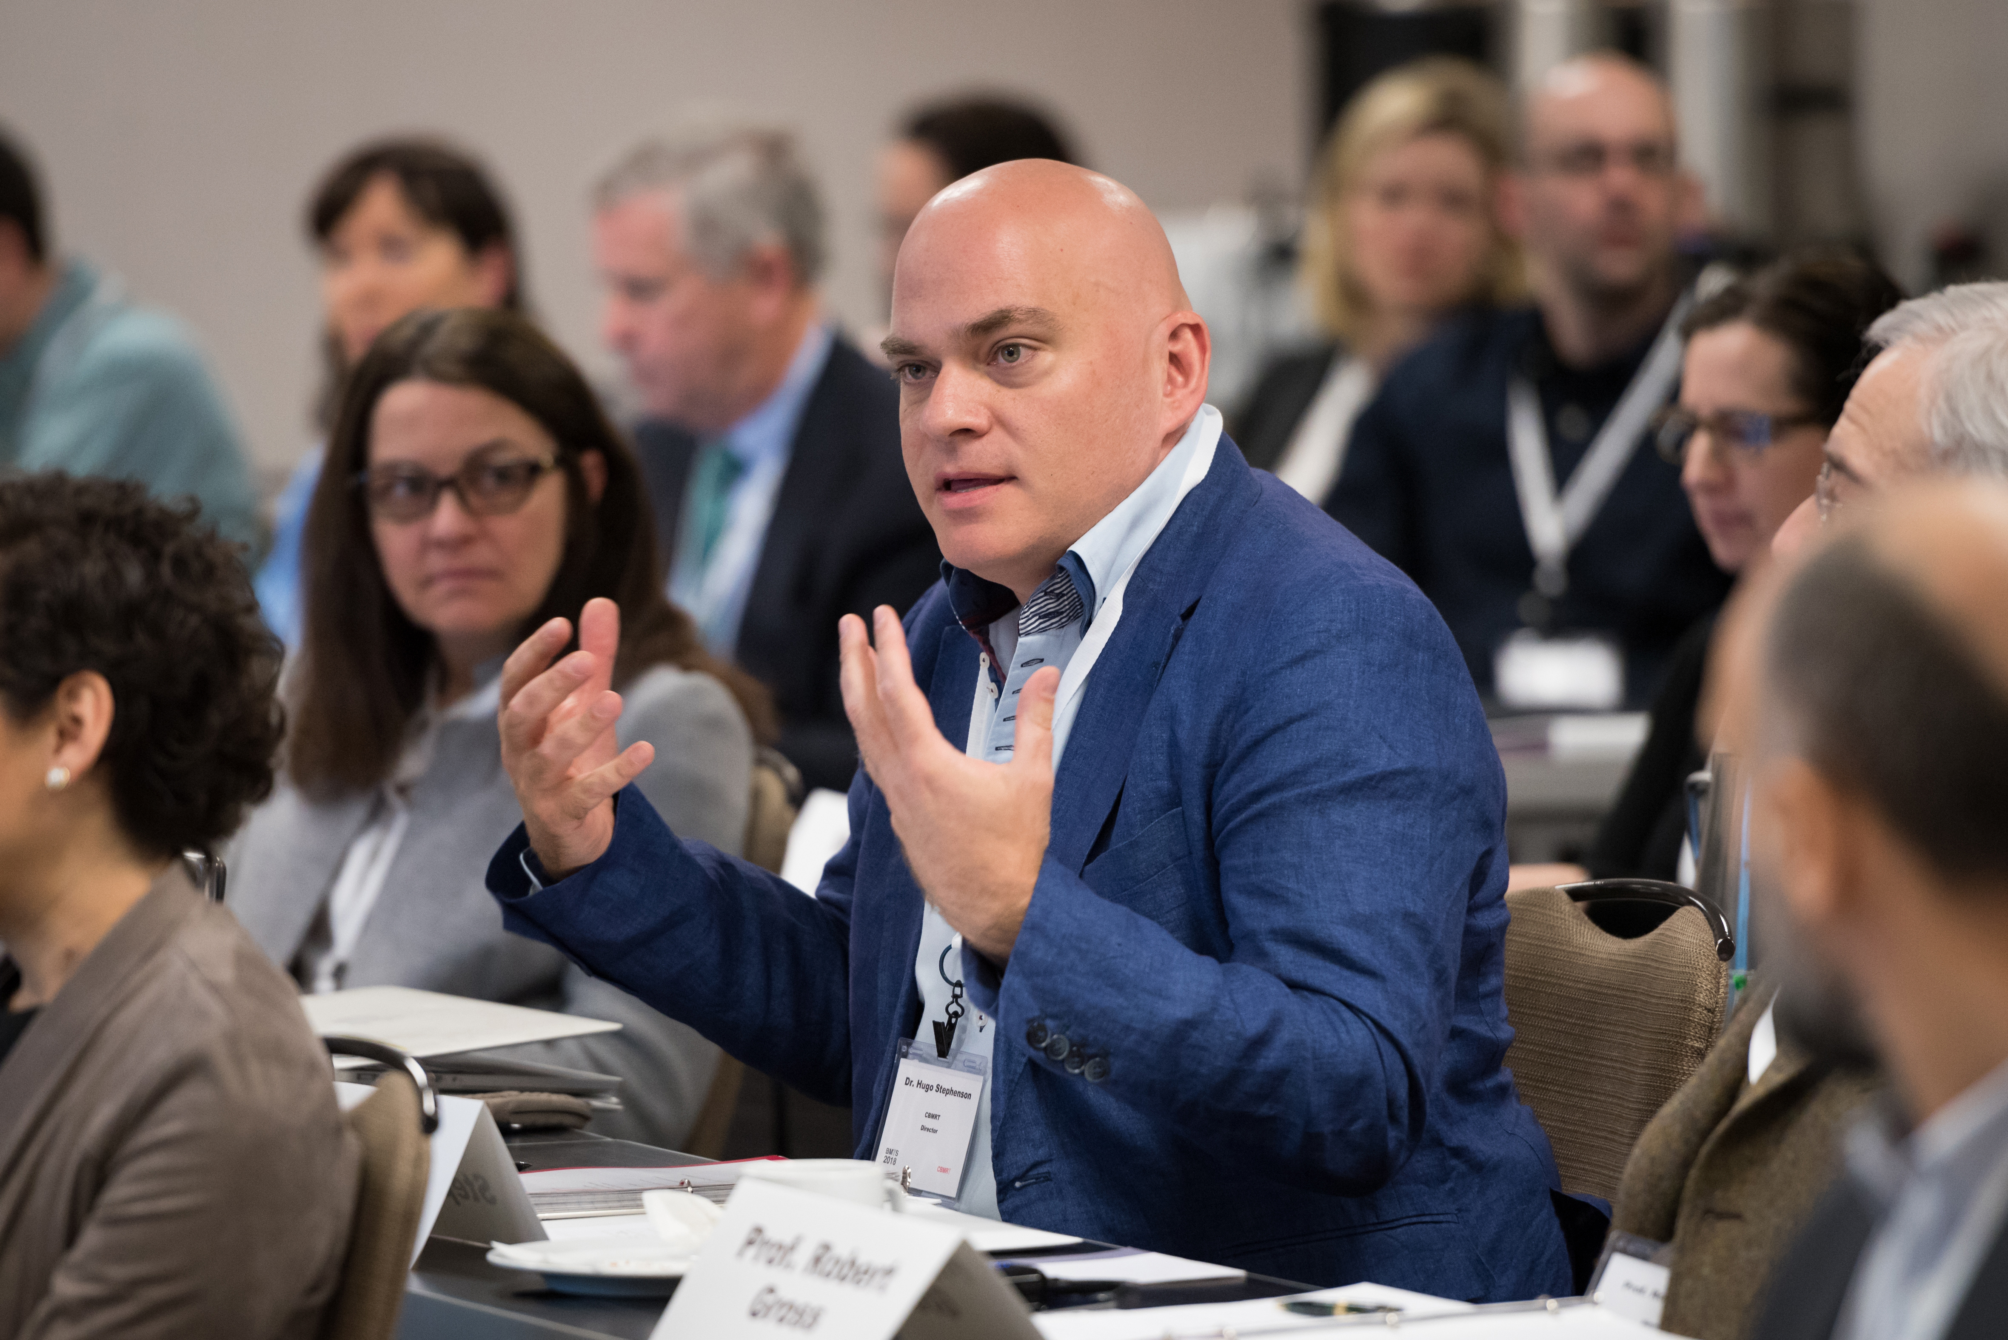
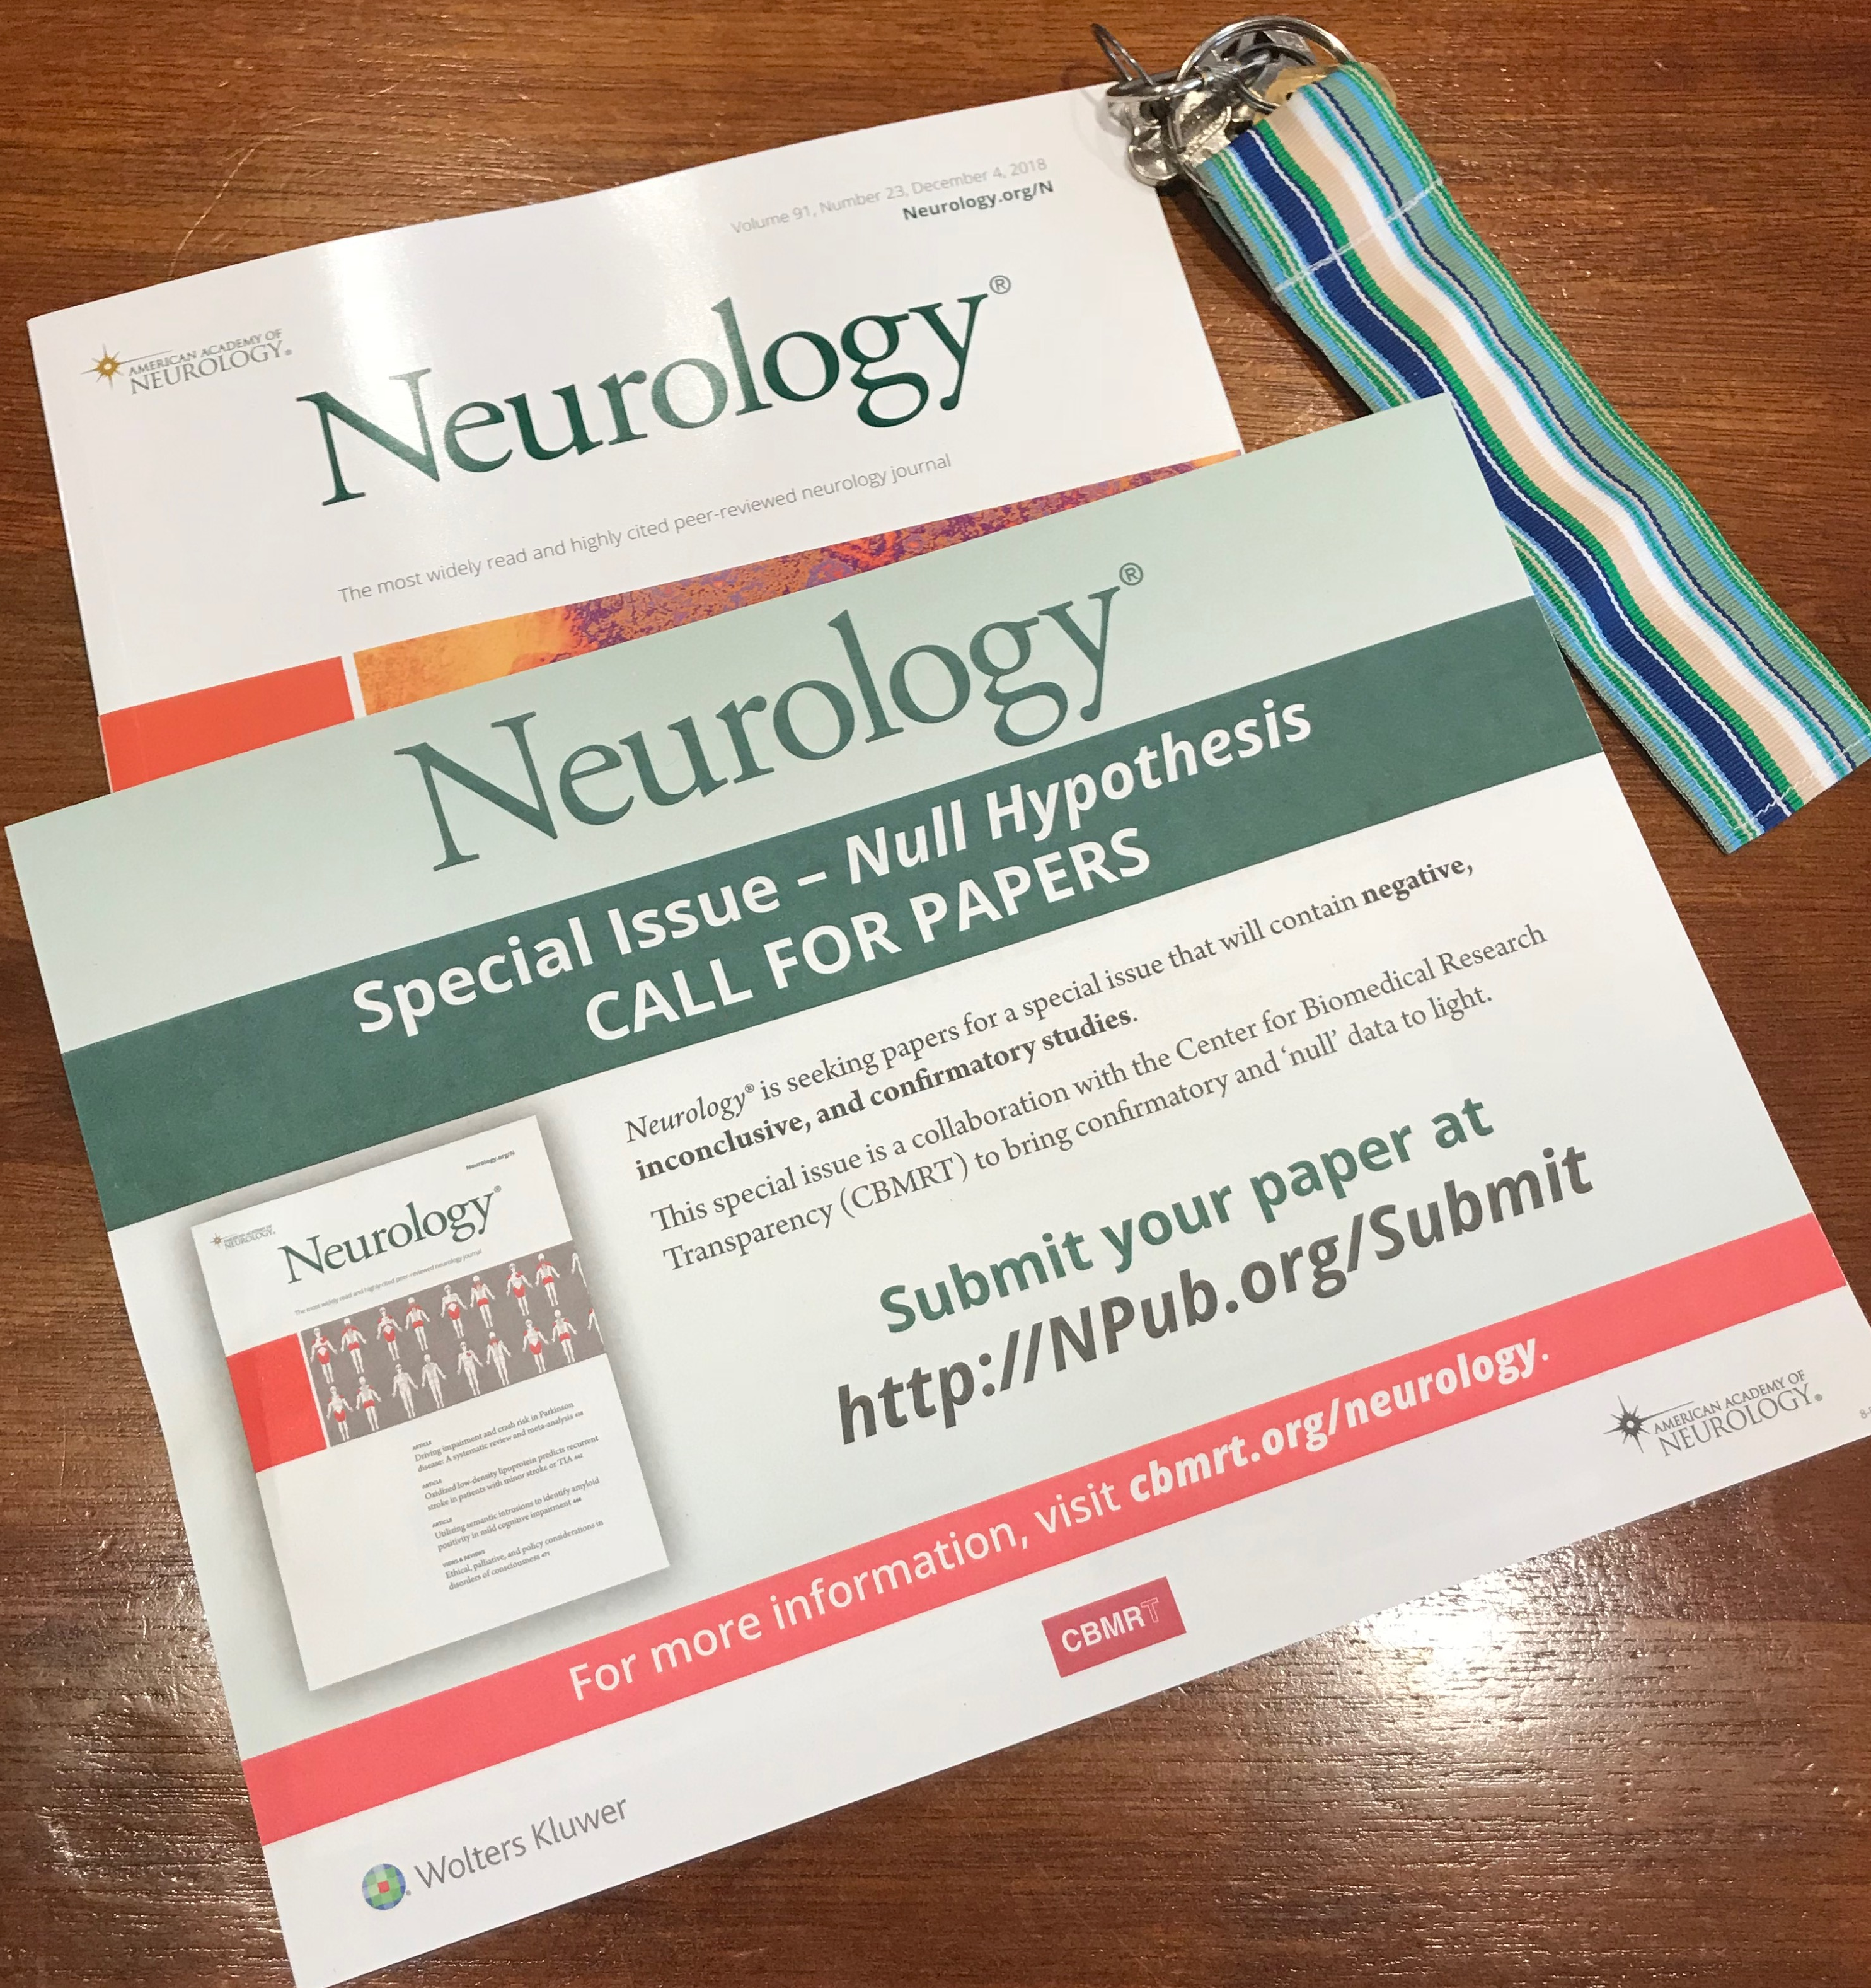
CBMRT Major Projects
Biomedical Transparency Summit Series
The Null Hypothesis Initiative
Ambassador Network

Slide 4
Null Hypothesis Update
Background
Null Hypothesis Development
Neurology® Null Hypothesis
1st edition
Paper review
Author perspective video What we’ve learned
Future directions

Slide 5
Research Transparency
Biomedical and clinical research reporting needs to be fully represented and transparent
Enhance efficiency
Reduce significant funding wastage
Inform future research design
To reduce avoidable risks to patients

Slide 6
Health Research cannot afford reproducibility and reporting issues.
“The scandal of poor medical research”
DG Altman Editorial from BMJ in 1994
“Additional tools and mechanisms are needed to rectify lack of timely reporting and publication…
impair the research enterprise
threaten to undermine evidence based clinical decision making”
Chen et al BMJ 2016;352:i637

Slide 7
Health Research cannot afford reproducibility and reporting issues.
We need to reduce research wastage
Estimated at $170 billion per annum!
Through:
Non-publication of results
Insufficient description of research – including endpoints, methodology, statistics and results
Lack of systematic review
Glasziou and Chalmers – BMJ 2016, 2017, 2018

Slide 8
Systematic issues with ”negative” result publication
“Clinical trials with positive outcomes have significantly higher rates and shorter times to publication than those with negative results”
- Pilar Suñé PLoS 2013
https://journals.plos.org/plosone/article?id=10.1371/journal.pone.0054583

Slide 9
The “Negative” Result - Challenges
Researcher perception of negative impact of reporting “negative” studies
Opportunity cost to write up
Institutional benchmarks often relying on publication impact factors, intense competition for these journals
Publication business models often reflecting “commercial value” – Impact factors/citations, subscriptions, reprint purchasing agreements.
Will my paper just be rejected anyway?

Slide 10
Systematic challenges
Where might this tend to lead?
Publication bias
Dark data
Cherry Picking
Spin
Reproducibility crisis
Losing the value of the scientific questioning process
Where we should ask “What can we learn from this data?”
There is scientific value in better reporting standards.

Slide 11
Dark Data
Biomedicine’s unpublished data
in lab books around the world
Many experimental results remain unpublished
This includes negative/inconclusive/replication findings
Significant value!
Inform future research design, funding decisions, and save study participants from avoidable risks.

Slide 12
The Null Hypothesis Initiative (H₀)
Subscription business model or independent journal challenging
Create dedicated space in existing journals
Promote a change in publication culture
Co-write editorials, liaise with stakeholders
CBMRT non-profit as a fundraising source
Working with major societies and their flagship journals
Utilizing existing networks and infrastructure
Promoting the special edition among researchers and society members
Enhancing research reporting culture

Slide 13
The Null Hypothesis Initiative (H₀)
For null result papers, but also other well-designed yet commonly perceived as harder to publish studies
Well-performed studies
Negative “null” results
Inconclusive results
Replication studies
So researchers can just say it how it is

Slide 14
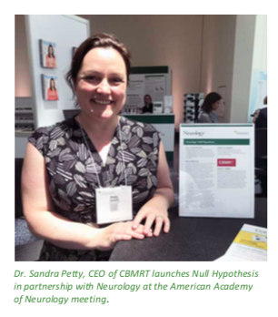
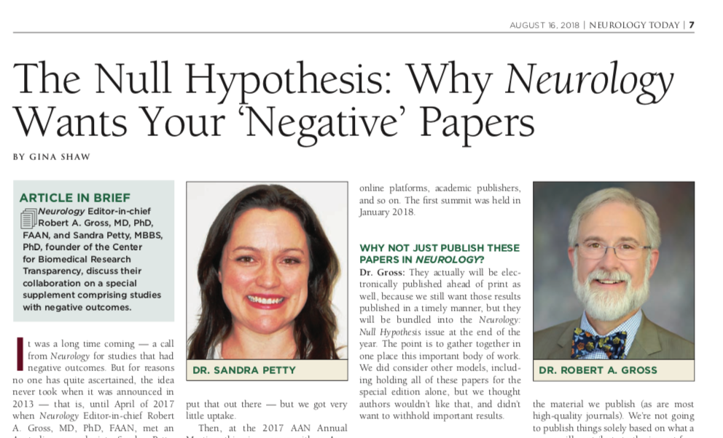
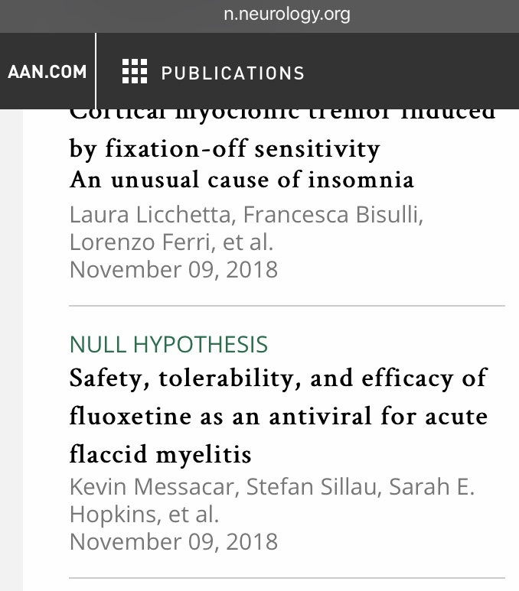
Neurology® Null Hypothesis

Slide 15
Creating Neurology Null Hypothesis
White paper submitted to Neurology in 2017
Collaboration: Neurology®, Wolters Kluwer and CBMRT
Initiative launched American Academy of Neurology meeting, 2018
Editorial Board briefed
Information at publications booth
Special Editorial published in Neurology® 2018
Call for papers online, in print and in Neurology Today®
Neurology® Null Hypothesis papers appear online ahead of print on Neurology® website as accepted

Slide 16
Here it is!
White paper submitted to Neurology in 2017
Collaboration: Neurology®, Wolters Kluwer and CBMRT
Initiative launched American Academy of Neurology meeting 2018
Editorial Board briefed
Information at publications booth
Special Editorial published in Neurology® 2018
Call for papers online, in print and in Neurology Today®
Neurology® Null Hypothesis papers appear online ahead of print on Neurology® website as accepted
MoU to continue Null Hypothesis section for next 2 years negotiated in 2019

Slide 17
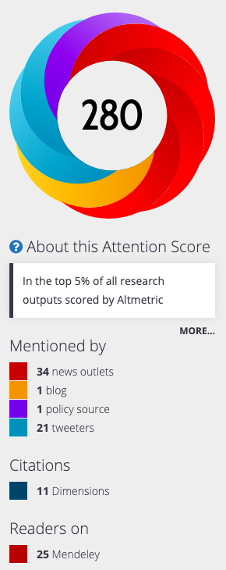
Neurology Null Hypothesis
Messacar et al. Safety, tolerability, and efficacy of fluoxetine as an antiviral for acute flaccid myelitis. Neurology, November 2018
This study demonstrated tolerability but not efficacy in a retrospective study in response to an outbreak of EV-D68 acute flaccid myelitis, as an off-label treatment in the context of efficacy failure of known treatments.

Slide 18
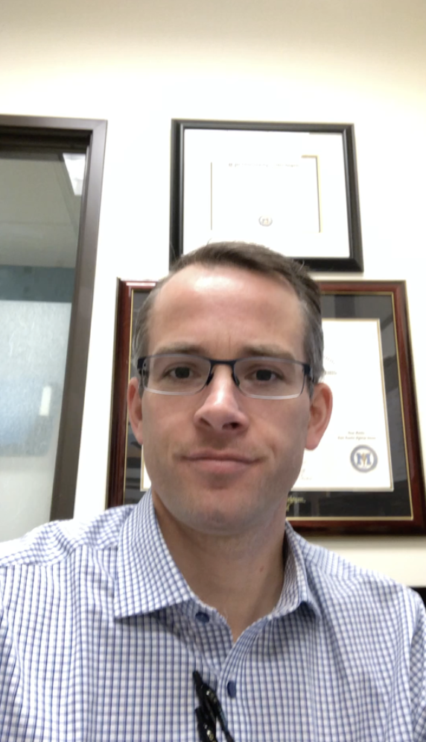
Author Feedback
Kevin Messacar, MD Assistant Professor Department of Pediatrics,
University of Colorado Children’s Hospital Colorado
https://www.dropbox.com/s/qdxuw25dchsz40n/Kevin%20Messacar%20H0%20video%20191205.mov?dl=0

Slide 19
Mainstream media coverage
“Last week, another potential treatment was found to be ineffective: A study in the journal Neurology found that the antidepressant fluoxetine, which had inhibited enterovirus D68 in lab tests, did not improve muscle strength in children with AFM.”
Lena H. Sun, Washington Post, November 13, 2018
Time Magazine featured the article on November 9, 2018
Summarized the findings and nature of the study for a general public audience
Also highlighted that CDC officials had commented to Time in October that finding a cause and a treatment were a priority

Slide 20
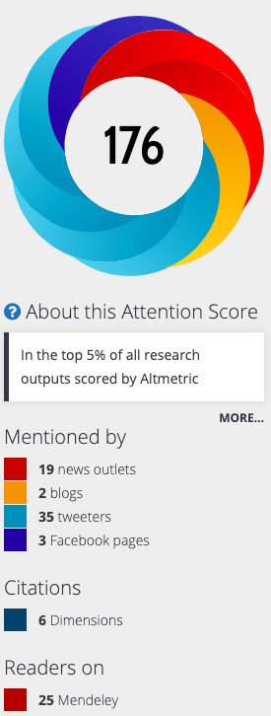
INTREPAD STUDY
April 30, 2019; 92 (18) NULL HYPOTHESIS OPEN ACCESS
INTREPAD
A randomized trial of naproxen to slow progress of
presymptomatic Alzheimer disease
Pierre-François Meyer er al.
First published April 5, 2019,
This study showed no significant effect in slowing Alzheimer disease
Excess of side effects – including constipation, dyspnea, hypertension, and petechiae.

Slide 21
Metrics
First Author | Year | Months | Free / Open | Citation (Google) | Mendeley Saves | Altmetric | Full Text PDF Usage
Messacar, K | 2018 | 14 | Free | 18 | 19 | 280 | 2505
Bjornevik, K | 2018 | 14 | Free | 1 | 6 | 13 | 1051
Lochmüller, H | 2019 | 12 | Open | 4 | 10 | 3 | 1499
Witsch, J | 2019 | 11 | Free | 1 | 5 | 9 | 706
Warendorf, J | 2019 | 11 | Free | 1 | 2 | 13 | 3279
Cubo, E | 2019 | 10 | Free | 2 | 7 | 15 | 1525
Bjornevik, K | 2019 | 10 | Free | 4 | 8 | 14 | 1261
Cortese, M | 2019 | 9 | Free | 1 | 6 | 71 | 1586
Galhardoni, R | 2019 | 9 | Free | 5 | 25 | 1 | 1894
Gaastra, B | 2019 | 9 | Free | 4 | 4 | 10 | 844
Meyer, P-F | 2019 | 9 | Open | 14 | 16 | 176 | 3750
Neville, I | 2019 | 7 | Open | 0 | 4 | 21 | 2497
Overwater, I | 2019 | 7 | Free | 3 | 12 | 9 | 273
Cumming, T | 2019 | 6 | Free | 0 | 9 | 21 | 289
Hupperts, R | 2019 | 3 | Open | 4 | 6 | 33 | 1160

Slide 22
Momentum!
Neurology® Null Hypothesis delivered
Positive feedback from Neurology, authors and neurologists
Papers still being submitted and published
Papers published online ahead of print
Papers have been useful!
usage, citation and altmetrics
Further 2 year MoU with Neurology in place

Slide 23
Future Directions – what’s needed?
Further opportunity and support for scientists to publish their well-performed research studies
Identify fields in basic and clinical research who would benefit from the Null Hypothesis initiative
Dedicated publishing space
Positive press for well-performed studies
Working with societies, editors and journals
Research publication culture enhancement
Funding
Can you or your organization nominate and support a field to achieve this?

Slide 24
What we have learned
Business model for publishing negative papers is challenging in a for-profit publication environment
Publishing well-performed “negative” results will reduce research funding wastage
The papers are useful – citable, of public interest and capable of informing research design and enhancing systematic review
Changing publication culture is rapidly achievable using a promotion and facilitation approach
(Do not call it a supplement!)
“Negative” results should not carry a negative stigma
Funding is needed to support enhanced publication approaches

Slide 25
Future Directions - What’s needed?
Systematic integrated approach to reporting results
Across funders, ethics committees, researchers, research publication media
Infrastructure and metrics to enhance research reporting
How can we ensure we are closing the loop on research with publication and patient summaries?
?Funder requirements / IRB & ethics committees / institution and organization level
Addressing publication bias
Funding project timelines including time to write up
Supporting researchers to publish their work

Slide 26
What’s needed?
Review of cost and availability of quality publishing spaces, and representation of all study results
Available and appropriate spaces to publish studies - including negative, inconclusive and replication work
Expanding role for preprints and data sharing
Rethinking peer review processes and quality – transparency, COIs, prior approvals/pre/post review
Some new approaches – create badging for transparency / identify and track results including “negative/null”
Rebranding “Negative” studies as valid and valued results

Slide 27
Support CBMRT
Thank you for supporting the BMTS series
Join the Ambassador Network
Donate!
Can your organization support one of our major projects?
Nominate / support a biomedical or clinical research field for a Null Hypothesis publication
Email Sarah@cbmrt.org

Slide 28
Acknowledgements – H₀
Robert Gross – Editor-in-Chief of Neurology®
Kim Jansen – Executive Publisher, Medical Journals - Wolters Kluwer
Patty Baskin
American Academy of Neurology
Neurology Reviewers, Editorial Board, authors and research participants
CBMRT board, staff and supporters

Slide 29
Thank you
www.cbmrt.org
Sandy@cbmrt.org

