Slide 1
NIH Perspectives on Roles and Responsibilities for Promoting Research Integrity
Michael S Lauer, MD
Deputy Director for Extramural Research
National Institutes of Health
Center for Biomedical Research Transparency (CBMRT)
Friday, February 26, 2021 (Virtual)
Disclosures: None
Many thanks to: Patricia Valdez, PhD, Sally Amero PhD, and OD Colleagues

Slide 2
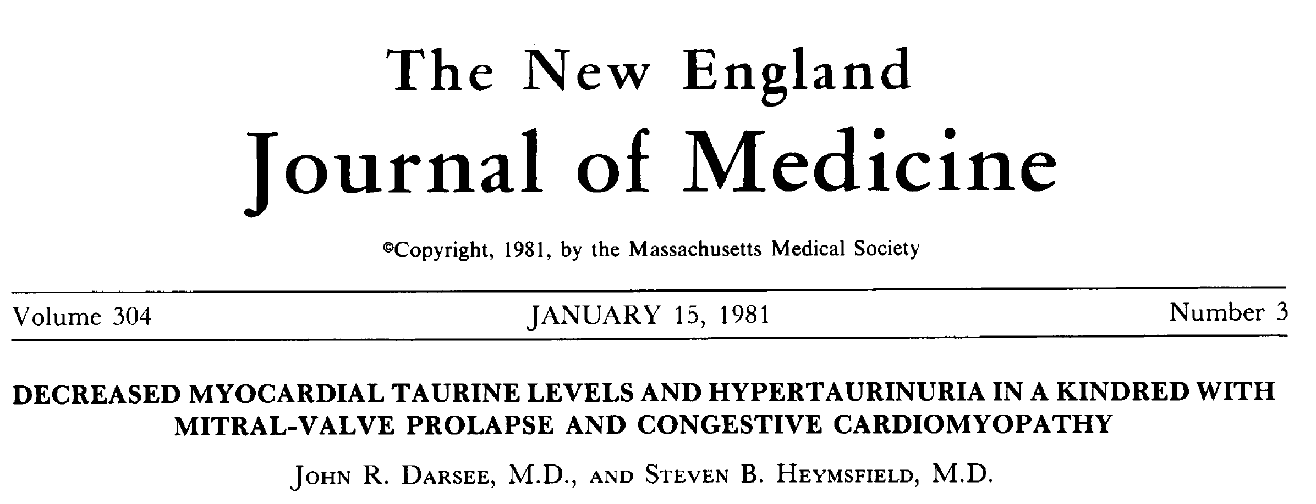
An Early Story

Slide 3
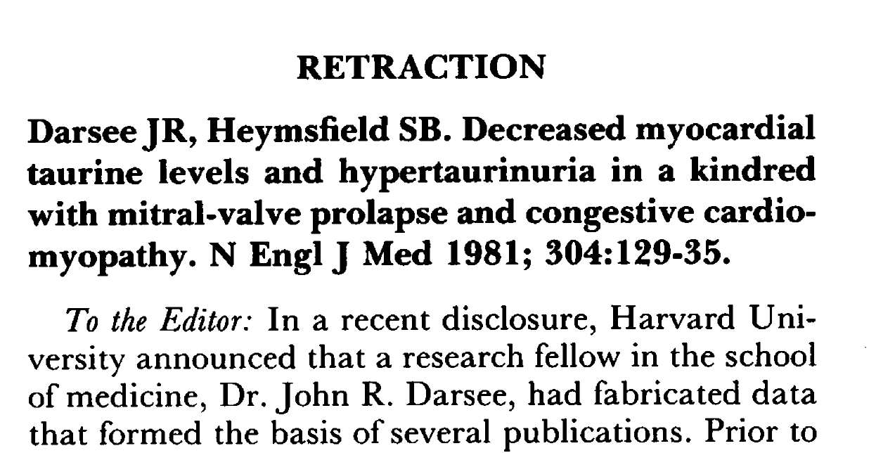
Investigations … and … Retraction

Slide 4
Lessons Learned
Academic system afforded him opportunity to fabricate
Some kind of inner pathology
Critical need to set standards
“Clever cheat difficult to expose”
Peer review affords little protection
Tight supervision, oversight essential
What is the meaning of co-authorship?
Relman A. N Engl J Med. 1983;308:1415-7

Slide 5
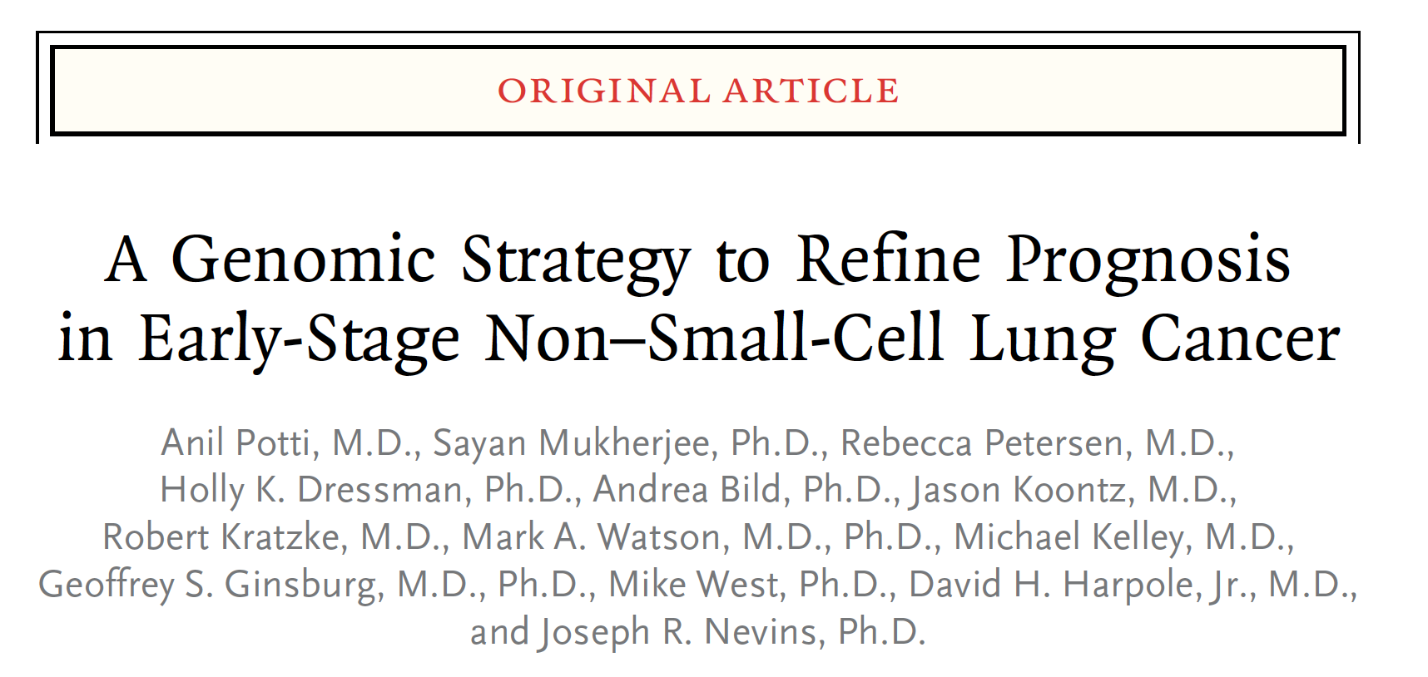
More Modern Story …

Slide 6
And Then Something Happened …

Slide 7
Collapse
In the end, four gene signature papers were retracted. Duke shut down three trials using the results. Dr. Potti resigned from Duke. He declined to be interviewed for this article. His collaborator and mentor, Dr. Nevins, no longer directs one of Duke’s genomics centers.
The cancer world is reeling.
The Duke researchers had even set up a company — now disbanded — and planned to sell their test to determine cancer treatments.

Slide 8
Some Differences
Struggling with complex data
Data sharing and forensic statistics
Role of peer review
Confluence of sins
Real harm – patients enrolled in trials
Still … clever cheat difficult to expose

Slide 9
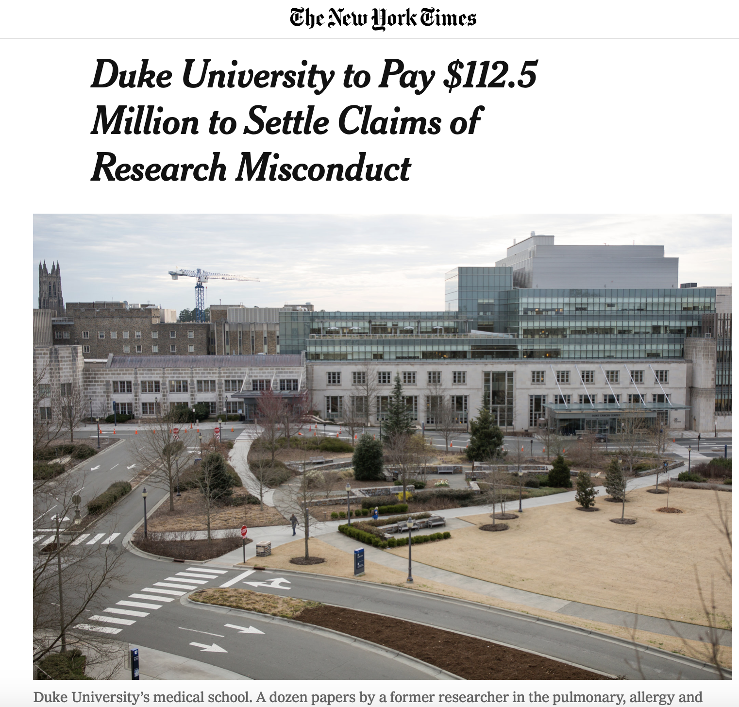
Shifting Focus …
“ Vincent E. Price, president of Duke University, said … ‘This is a difficult moment for Duke. This case demonstrates the devastating impact of research fraud and reinforces the need for all of us to have a focused commitment on promoting research integrity and accountability.’”
https://www.nytimes.com/2019/03/25/science/duke-settlement-research.html

Slide 10
US Government Worries
“Taxpayers expect and deserve that federal grant dollars will be used efficiently and honestly. Individuals and institutions that receive research funding from the federal government must be scrupulous in conducting research for the common good and rigorous in rooting out fraud,” said Matthew G.T. Martin, United States Attorney for the Middle District of North Carolina. “May this serve as a lesson that the use of false or fabricated data in grant applications or reports is completely unacceptable.”
https://www.justice.gov/opa/pr/duke-university-agrees-pay-us-1125-million-settle-false-claims-act-allegations-related

Slide 11
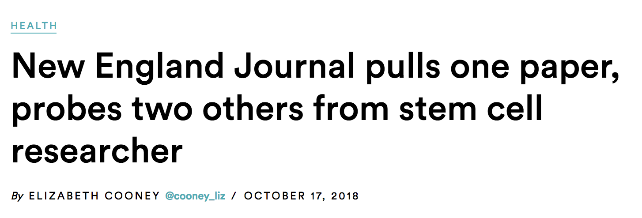
Endless Stories …

Slide 12
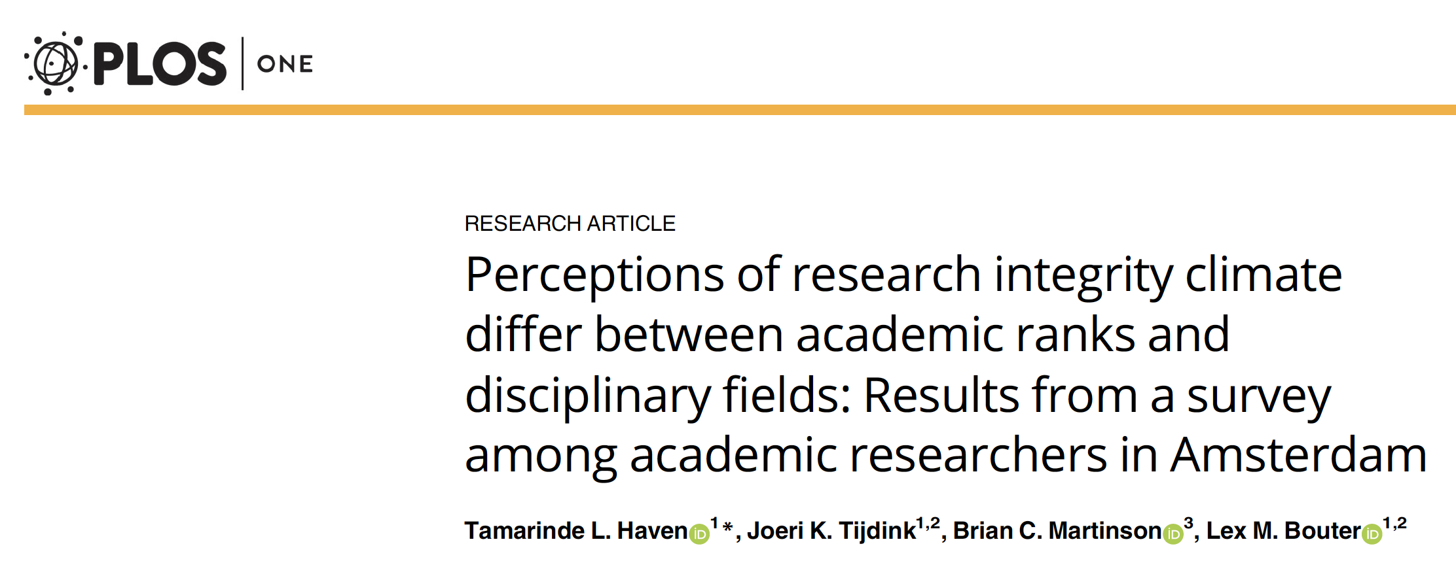
The Vocabulary Has Changed …
“Breaches of research integrity have shocked the academic community. Initially explanations were sought at the level of individual researchers but over time increased recognition emerged of the important role that the research integrity climate may play in influencing researchers’ (mis)behavior.”
PLoS ONE 14(1): e0210599. https://doi.org/10.1371/journal.pone.0210599

Slide 13
Our Vocabulary – The NIH Grants Policy Statement
NIH intends to uphold high ethical, health, and safety standards in both the conduct of the research it funds …Before NIH may make an award to a domestic organization, the AOR must certify ….
https://grants.nih.gov/grants/policy/nihgps/HTML5/section_4/4.1_public_policy_requirements_and_objectives.htm

Slide 14
“An Award … to a Domestic Organization”
Funding Employment
Steward Steward
NIH
Organization 1
PI 1
PI 2
Organization 2
PI 3
PI 4

Slide 15
Leveraging Institutional Leadership
https://grants.nih.gov/grants/guide/notice-files/NOT-OD-19-020.html

Slide 16
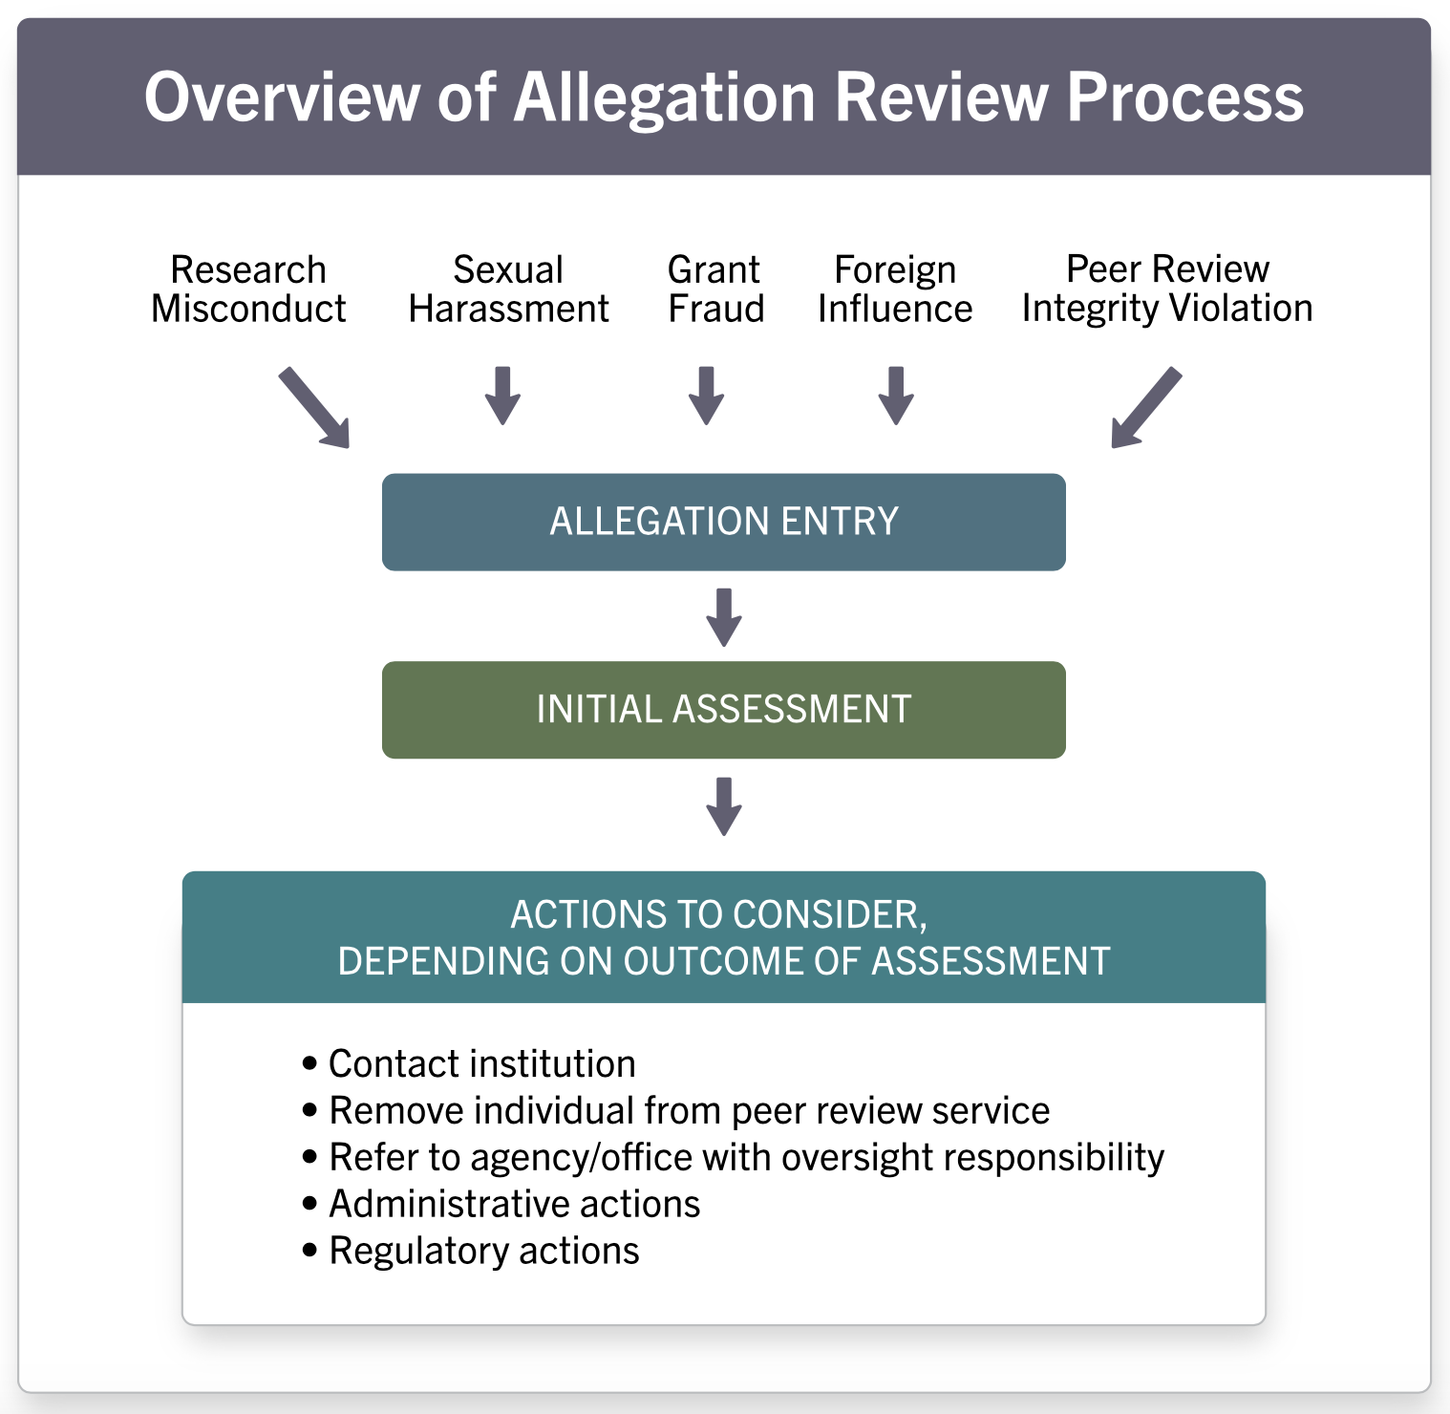
Multiple Types of Misconduct, Threats to Integrity
https://grants.nih.gov/images/simplified.svg

Slide 17
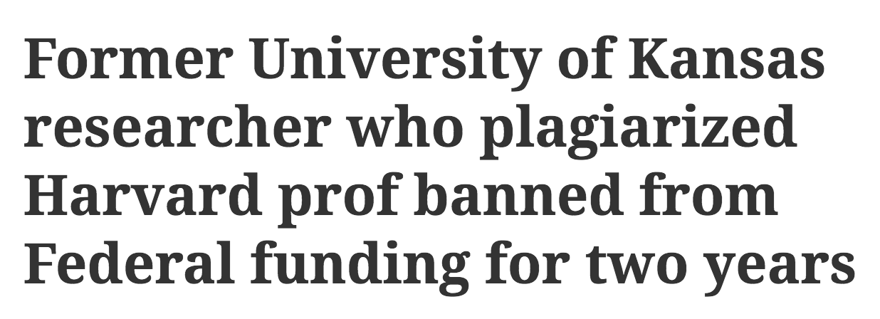
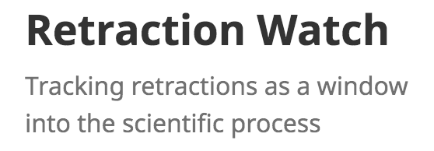
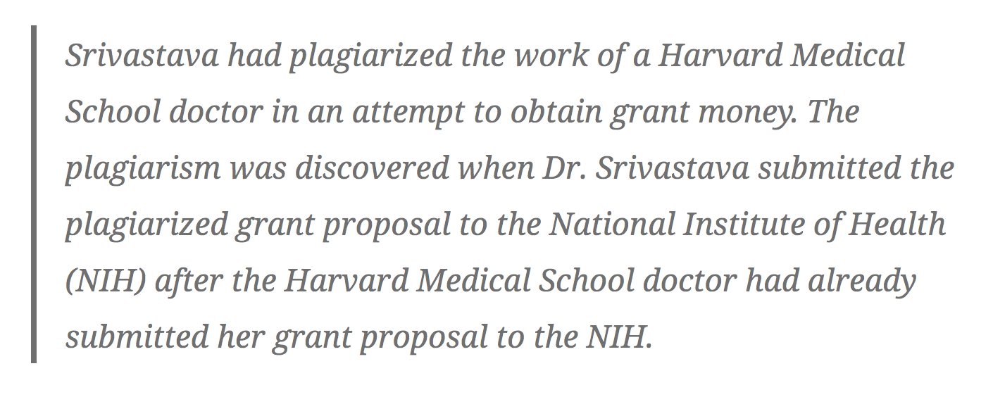
Peer Review
https://retractionwatch.com/2018/11/14/former-university-of-kansas-researcher-who-plagiarized-harvard-prof-banned-from-federal-funding-for-two-years/

Slide 18
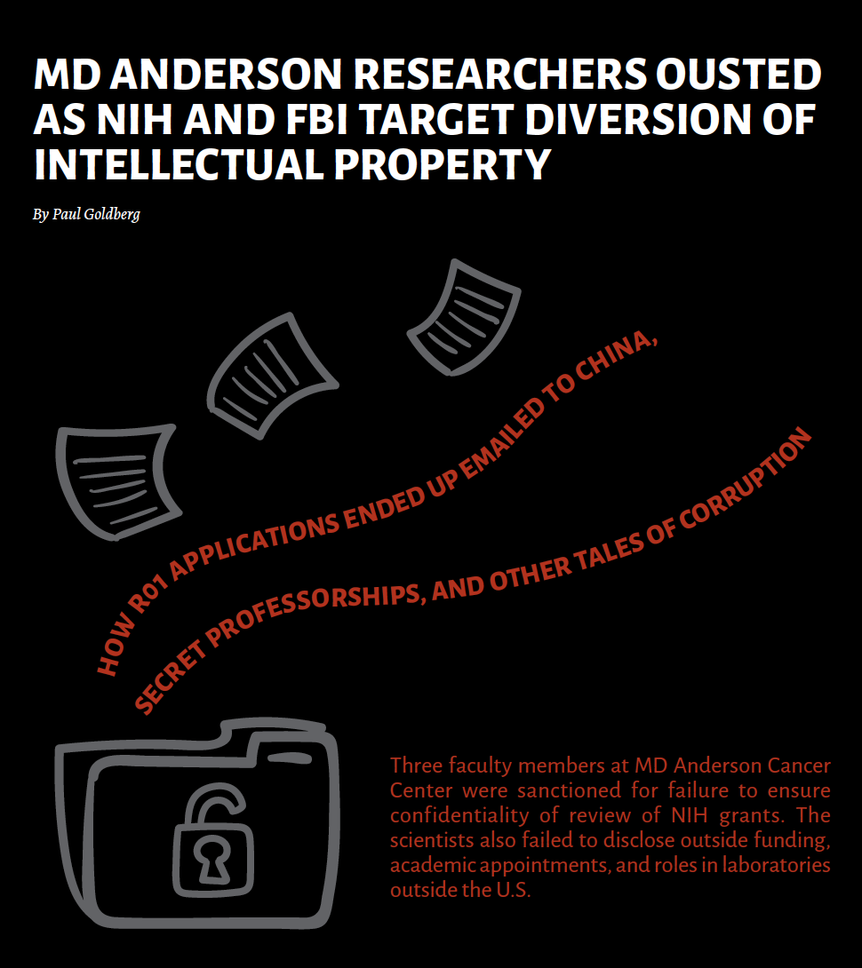
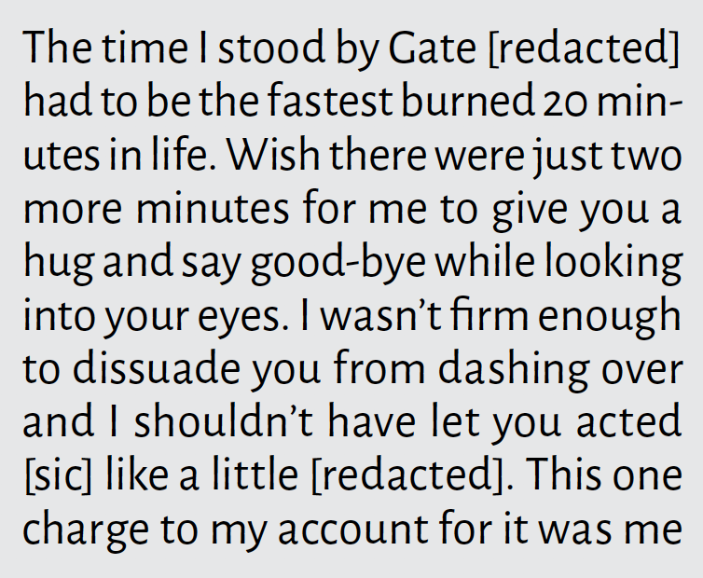
Peer Review (and Other Problems) on the International Front
“How R01 Applications Ended Up Emailed to China”
“Secret Professorships and Other Tales of Corruption”
Email from Reviewer to R01 applicant:
The Cancer Letter, April 26, 2019

Slide 19
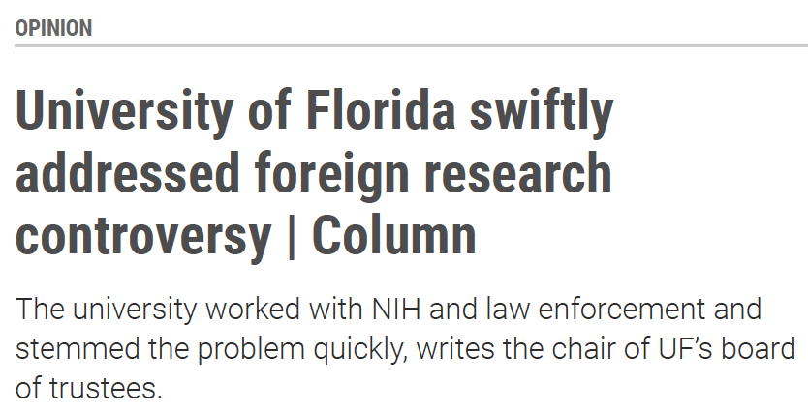
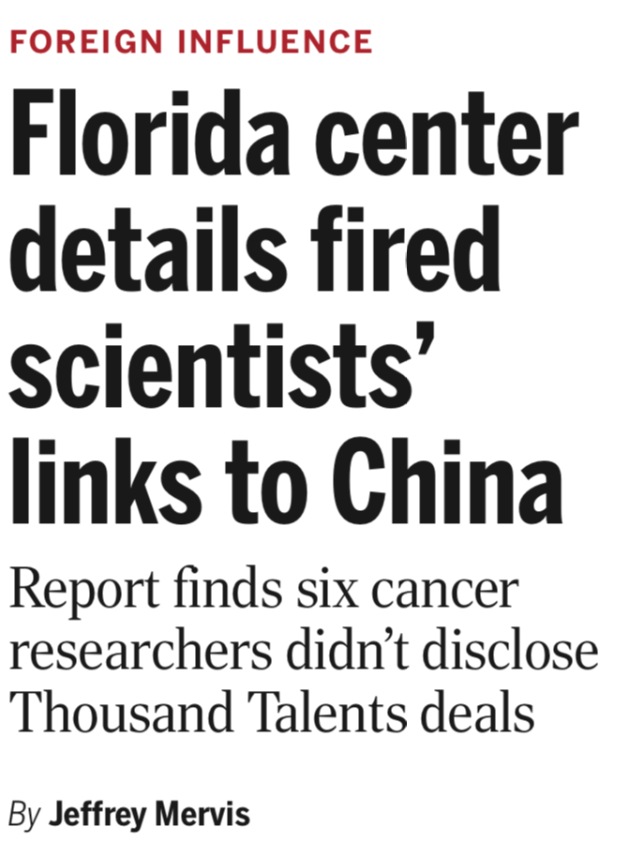
More Headlines

Slide 20
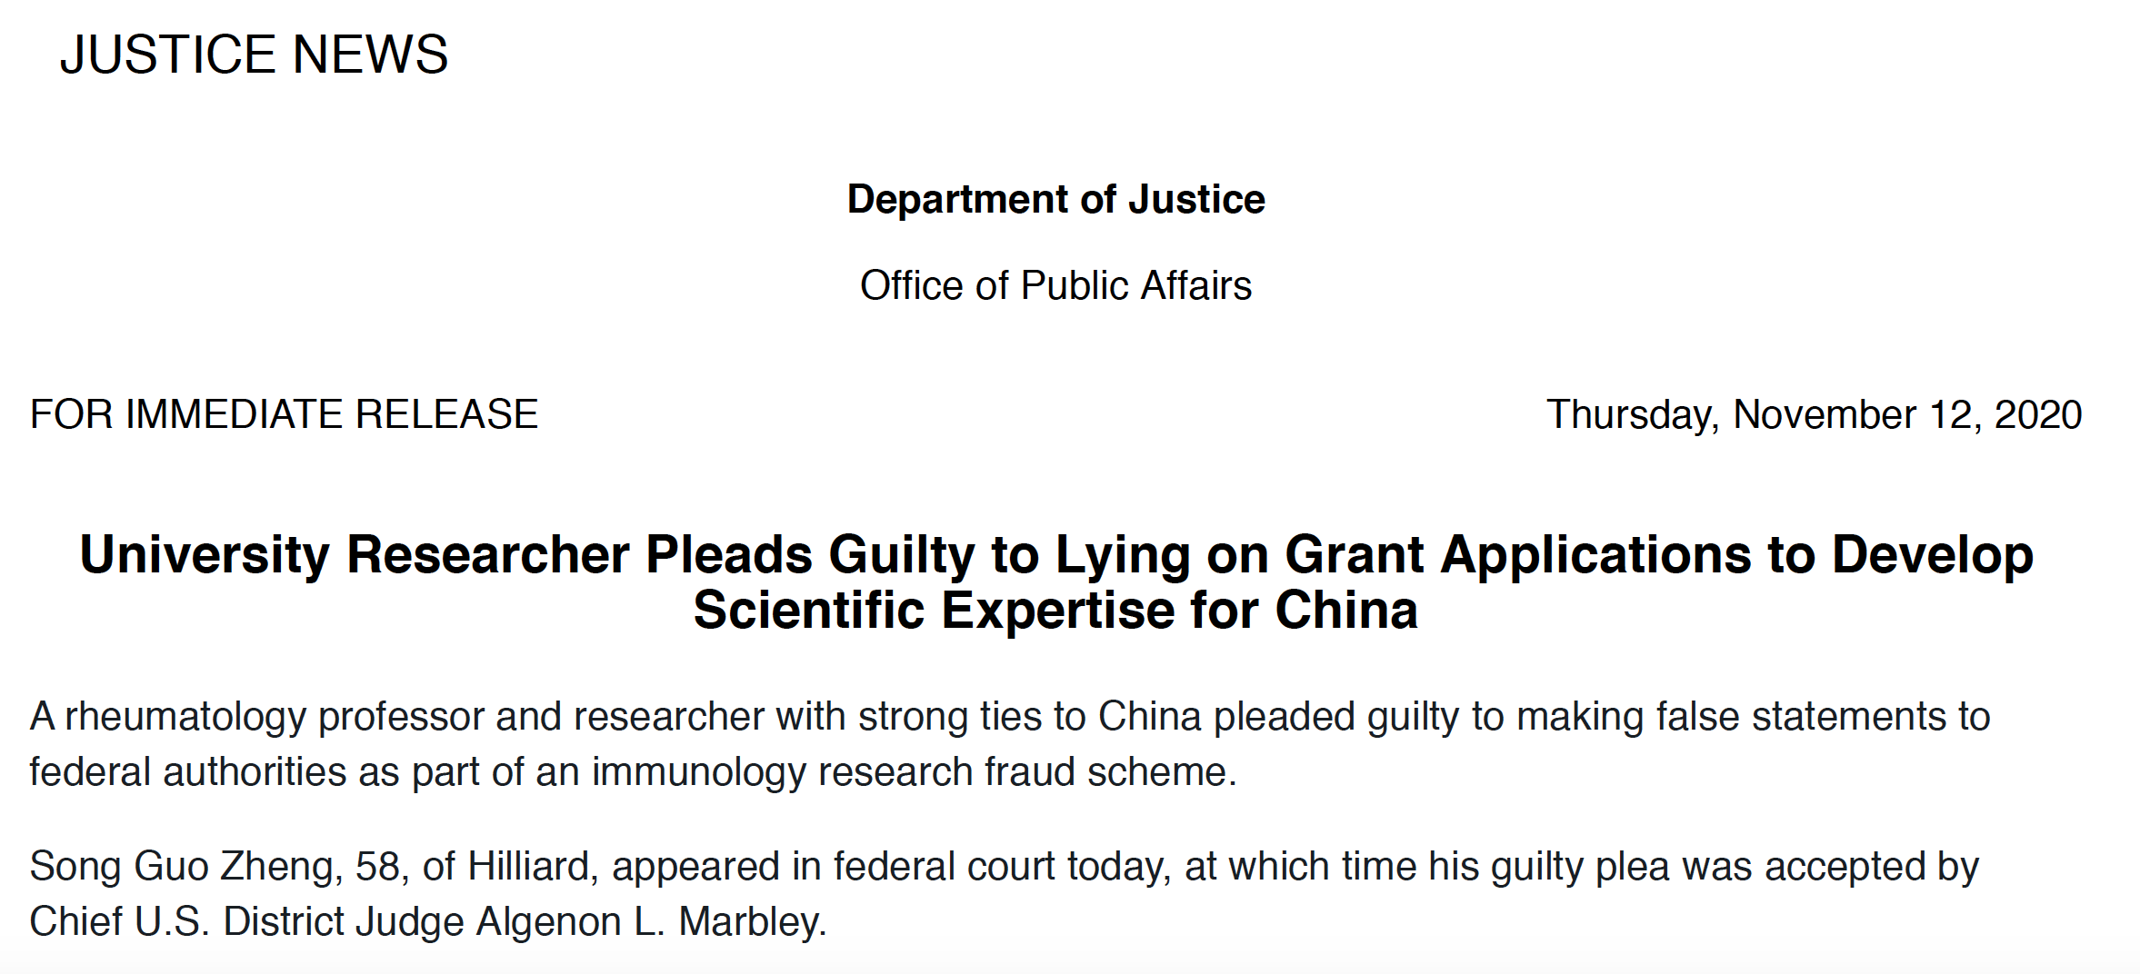
Lying on Grant Applications to Serve Foreign Interests

Slide 21
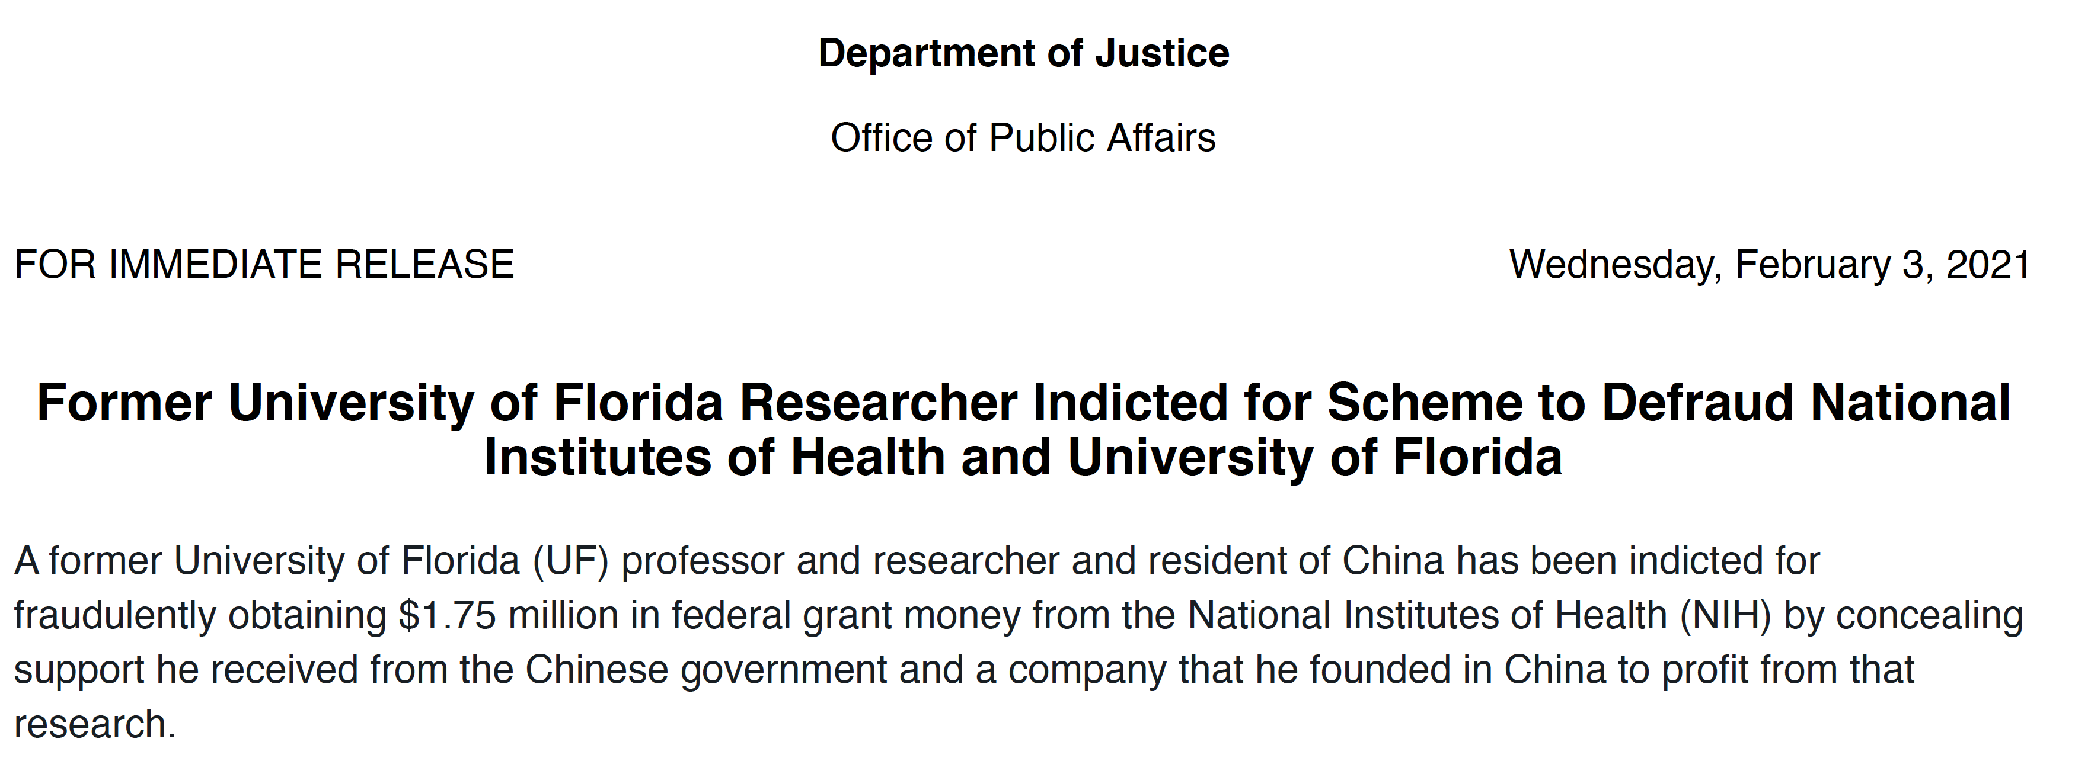
Lying to Serve Foreign and Personal Interests …

Slide 22
“Deep Informatics”
“During that same period, in 2016, Yang established a business in China known as ‘Deep Informatics.’ The indictment further alleges that Yang promoted his business in China by relating that its products were the result of years of research supported by millions of dollars of U.S. government funding. Simultaneously, Yang applied for and was accepted into the People’s Republic of China’s Thousand Talents Program (TTP) in connection with Northwestern Polytechnic University, located in Xi’an, China.”
https://www.justice.gov/opa/pr/former-university-florida-researcher-indicted-scheme-defraud-national-institutes-health-and

Slide 23
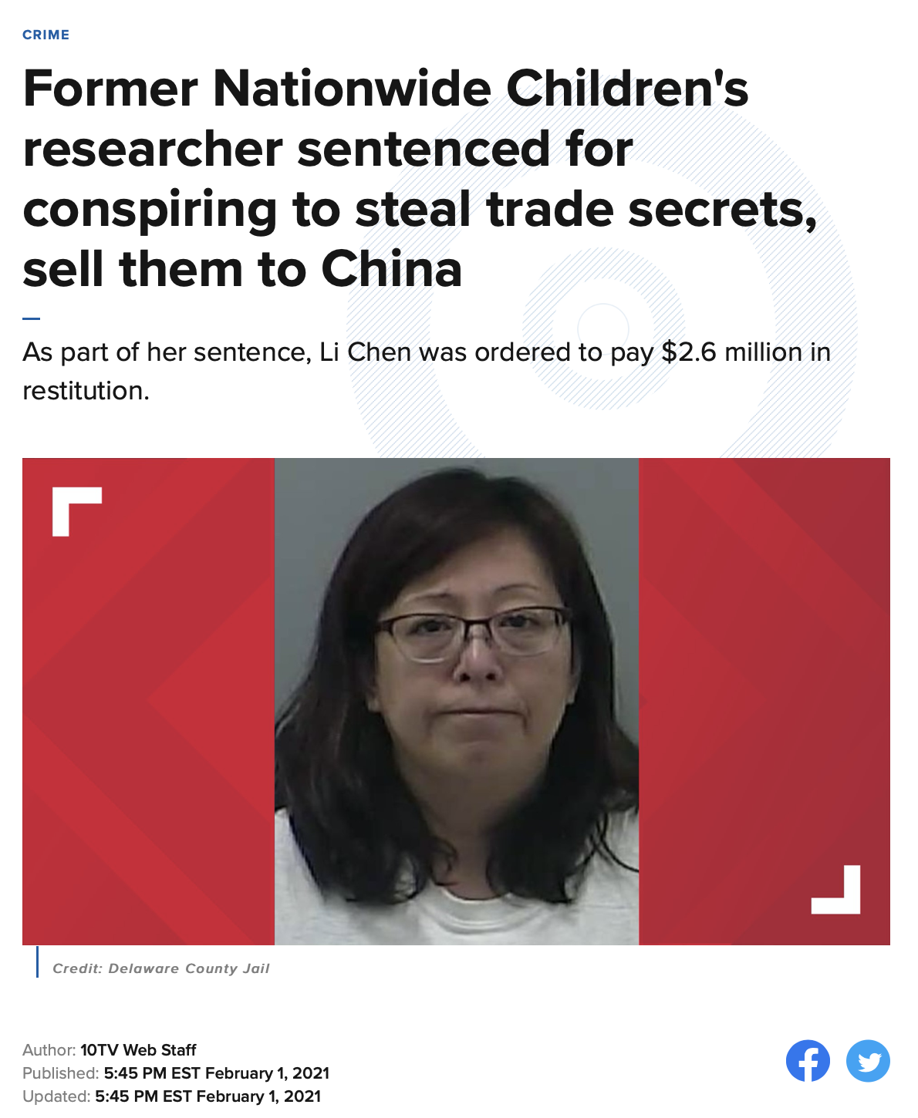
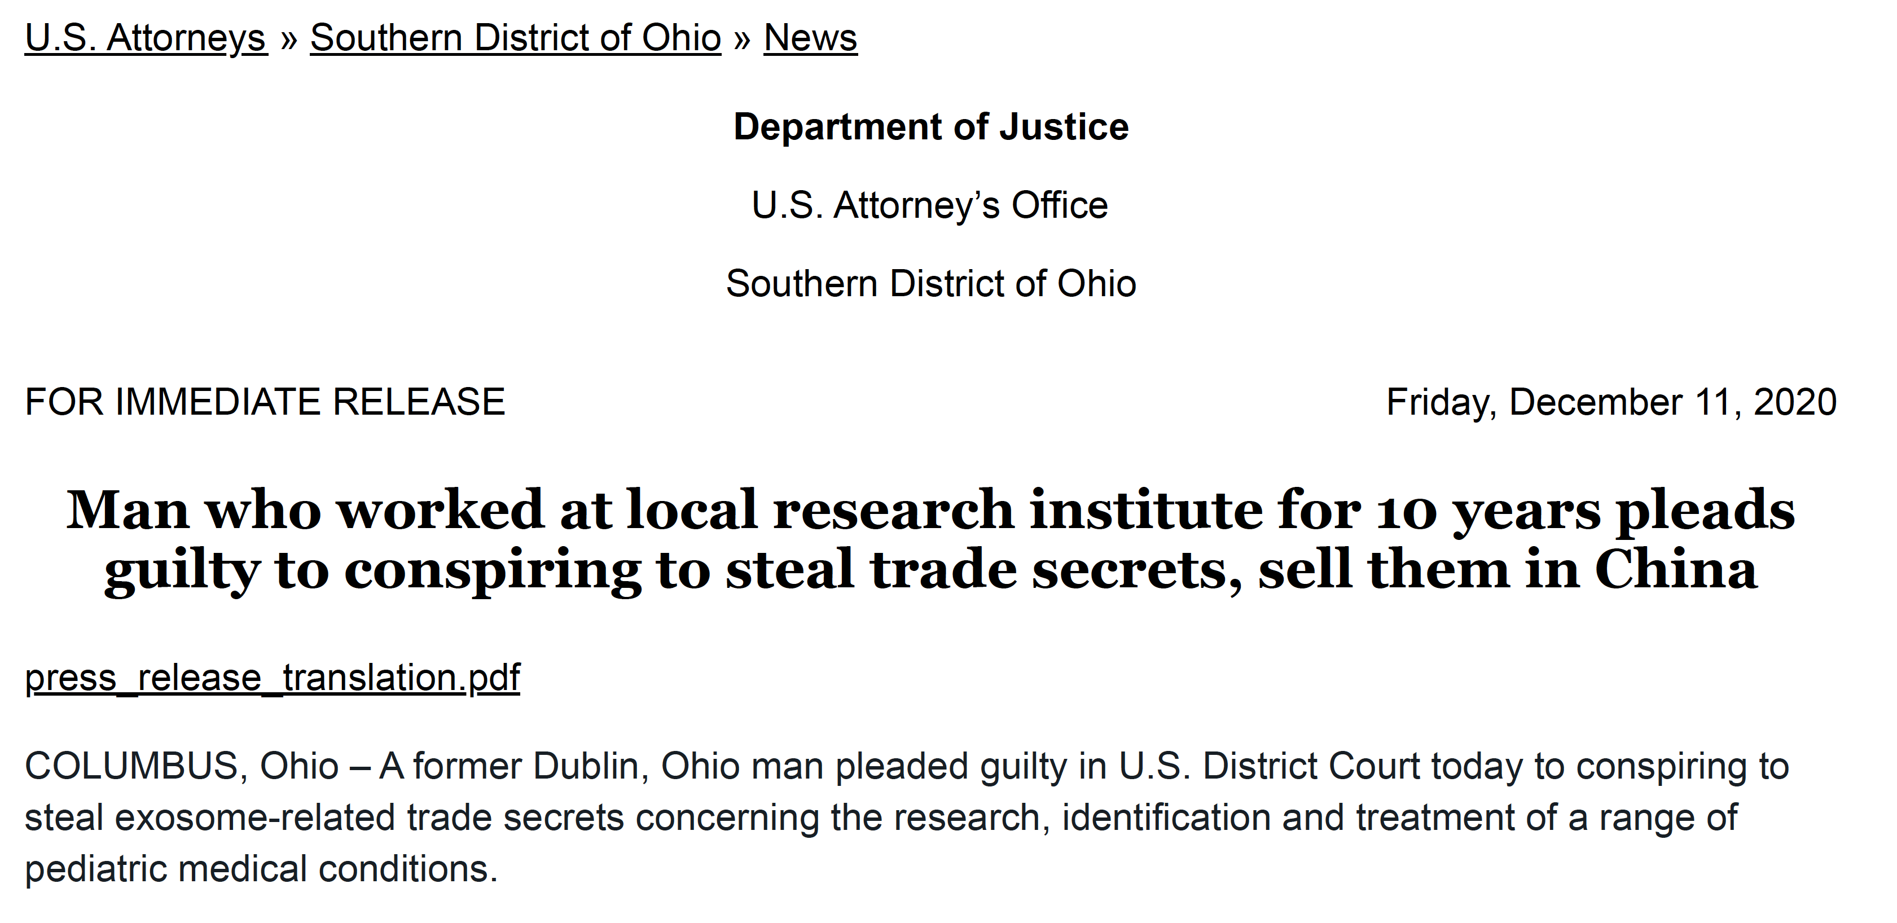
Post-Docs, Staff Scientists Founded a Company

Slide 24
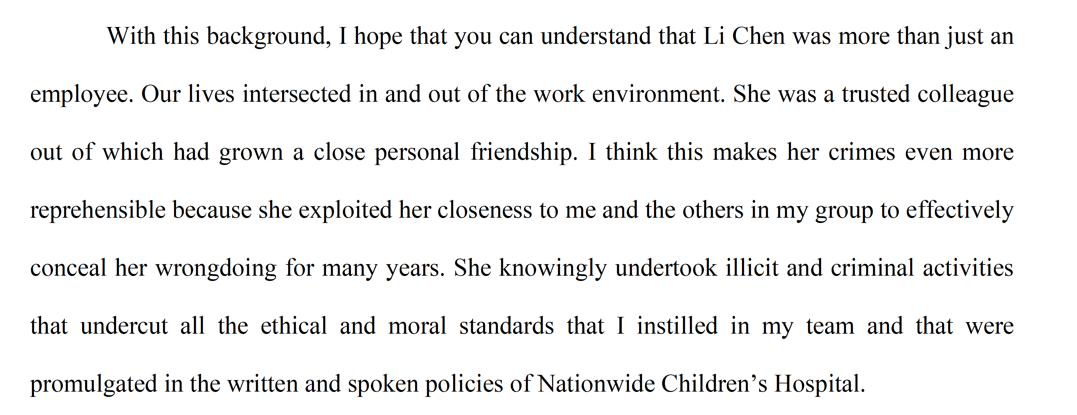
Victim Impact Statement

Slide 25
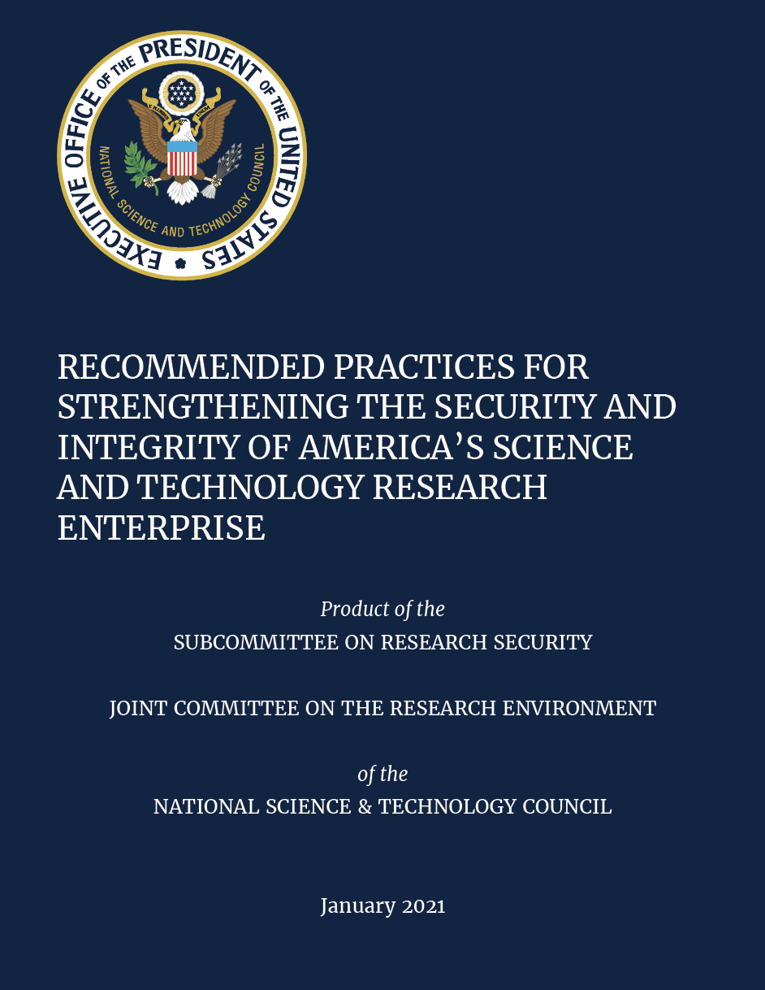
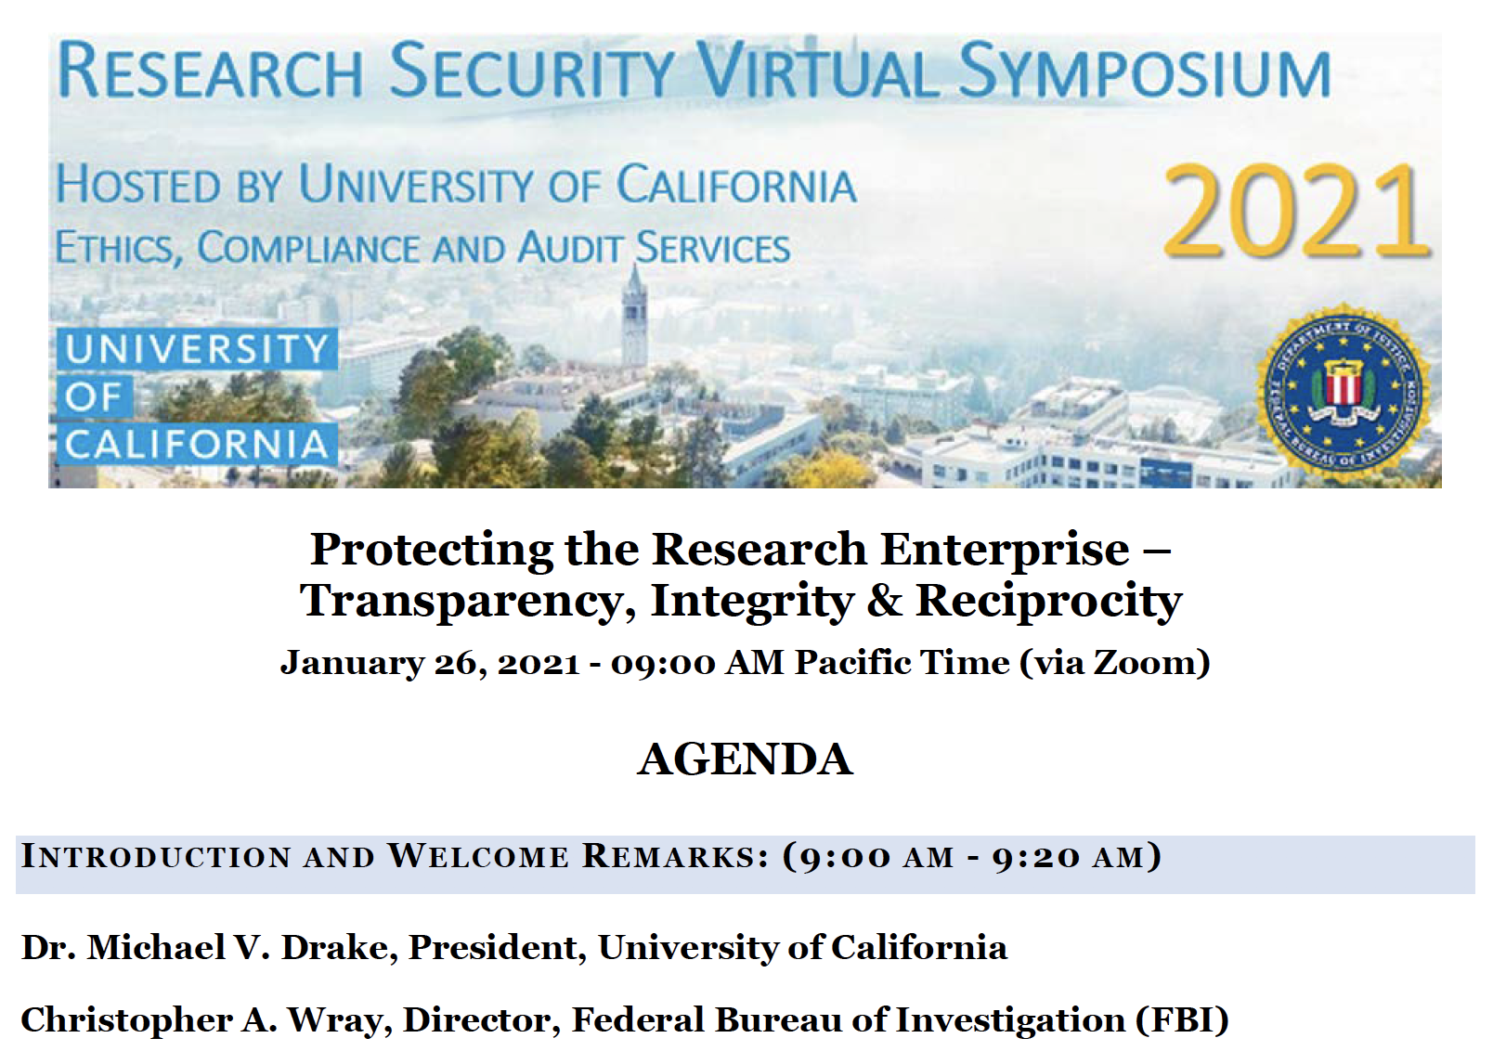
Outreach Updates

Slide 26
NIH View of Roles and Responsibilities
Outreach to institutions and leveraging reputational risks
Data forensics – institutions, research community
Law: Special award conditions, litigation (e.g. Duke)
Work with RIOs, ORI, OGC, OCR, OIG, FBI, DOJ, NSF
Staff training – e.g., SROs, RIOs
Leveraging behavioral economics – e.g. reminders
Promoting culture (e.g., ELN, outreach, actions)

